Slide 1
ICS 432 – 01 Distributed and Cloud Computing Fall 2021
Instructor: Thanaa Ghanem
thanaa.ghanem@metrostate.edu
Lecture 1
August 21, 2021

Slide 2
Welcome to ICS 432
Your Host: Thanaa Ghanem
Office: Founders Hall, 217
Email: thanaa.ghanem@metrostate.edu
Office Hours:
Mondays: 9:30 AM - 2:30 PM on Zoom
Fridays: 9:30 AM - 2:30 PM on Zoom
Zoom link: https://minnstate.zoom.us/j/94971304519
By appointment: Appointments are encouraged to prevent conflicts, even during office hours.
In-person meetings can be scheduled by email.
You are welcome to stop by my office whenever the door is open for any concern.
I am readily available by email.
Course syllabus is posted on D2L
Check D2L regularly for lecture slides, announcements, homework assignments, and grades.

Slide 3
Important Note
I am not going to follow a specific textbook for this course.
I use several online resources to prepare my course and lecture materials.
I try my best to references the sources for all the materials I use as much as I can.
Let me know if you think I used a resource without referencing and I will include the reference in materials.

Slide 4
Today’s Topics
Introduction to the course.
Course Syllabus.
Introduction to Cloud Computing

Slide 5
Today’s Topics
Introduction to the course
Course Syllabus.
Introduction to Cloud Computing

Slide 6
What is a computer?
At the most basic level, a computer is a device consisting of three pieces:
Compute: a processor to interpret and execute programs
Store: a memory to store both data and programs
Communicate: a mechanism for transferring data to and from the outside world.

Slide 7
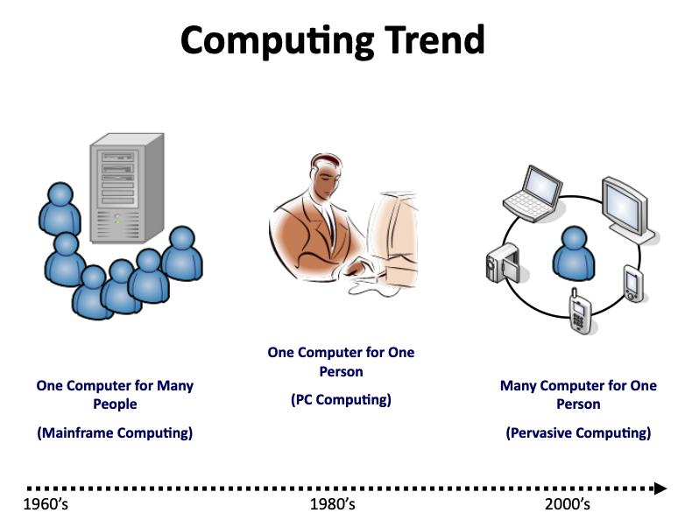
What is computing?
Computing is the activity of using computer hardware and software for some purpose

Slide 8

Carnegie Mellon
What Computing Paradigms Are There?
Personal
Super
Computing
Computing
Grid
Computing
Parallel
Cluster
Computing
Computing
Utility
Computing
Distributed
Cloud
Computing
Pervasive
Computing
Ubiquitous
Computing
Computing
Mobile
Computing

Slide 9
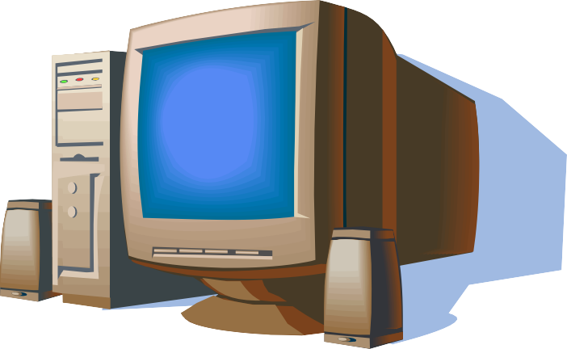
Computing Paradigms (1): Personal Computing
Carnegie Mellon
Personal computing system
Characterized by:
Local software installation, maintenance
Local system maintenance
Customizable to user needs
Very low utilization
High up‐front cost

Slide 10

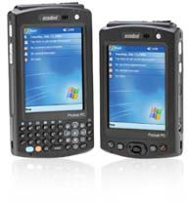
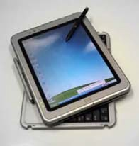
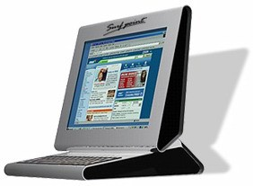
Computing Paradigms (2): Mobile Computing
Mobile computing refers to small size portable computers, hand-help and other small wearable devices.
You can use computing technology on the move
Since 1990s
Three basic components:
Network: for communication
Devices: computing units
Applications: for performing computation.
Characterized by:
Intermittent connectivity
Limited Bandwidth
Mobile device maturity

Slide 11
Existing Computing Paradigms ‐ Green Group
Carnegie Mellon
Ubiquitous
Pervasive
Computing
Computing

Slide 12
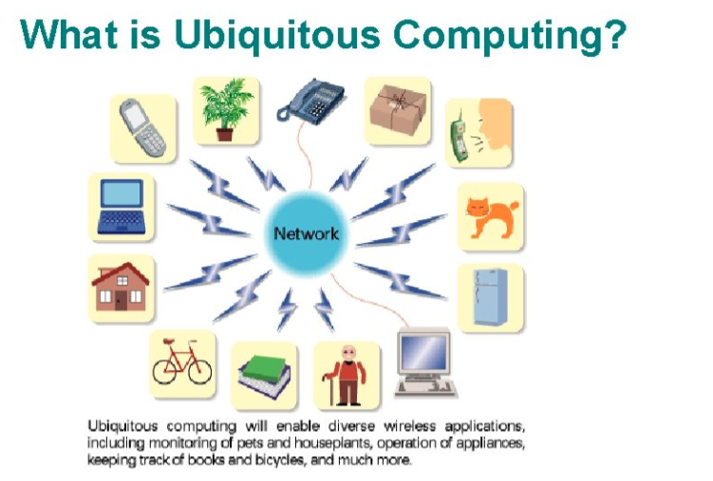
Computing Paradigms (3): Pervasive/Ubiquitous computing
Pervasive computing refers to the invisible and everywhere computing.
Ubiquitous – seeming to be in all places
Pervasive – present or noticeable in every part of a thing or place.
Making computers so embedded, so fitting, so natural that we use them without even thinking about them
Different models but same vision (small, inexpensive, robust devices distributed throughout everyday life)
Term used since 1980s

Slide 13
Pervasive/Ubiquitous computing (continued)
Characterized by:
Invisible: tiny, embedded, attachable
Everywhere: wireless, dynamically configurable, remote access, adapting.
Context Awareness: physical location, physiological state, emotional state, distraction free.

Slide 14
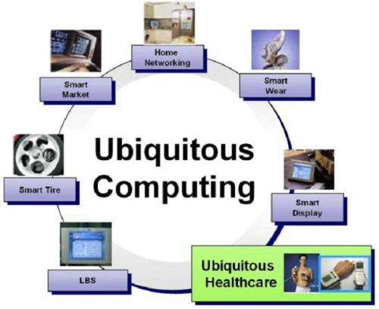
Examples on Pervasive Computing
Automatic adjustment of heating, cooling, and lighting levels in a rooms based on an occupant’s profile.
Refrigerators are aware of their suitable tagged contents, able to both plan a variety of menus from the food actually on hand and warn users of stake or spoiled food.

Slide 15
Existing Computing Paradigms ‐ Blue Group
Carnegie Mellon
Super
Computing
Grid
Computing
Cluster
Parallel
Computing
Computing
Distributed
Computing

Slide 16
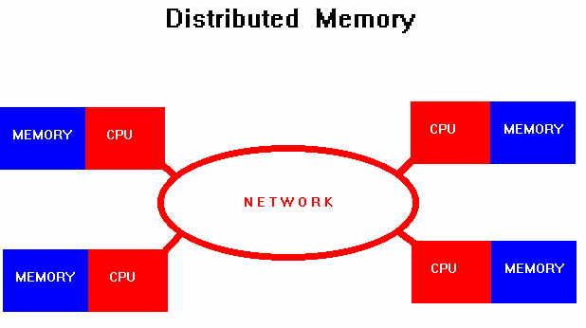

Computing Paradigms (4): Distributed Computing
Distributed computing refers to the use of distributed systems to solve computational problems.
Distributed System
consists of multiple autonomous computers that communicate through a computer network.
It appears to uses a single coherent system.
The system has a distributed memory where each processor has its private memory.
Information exchanged using communication models, for example message passing.

Slide 17
Distributed Computing (continued)
Distributed systems are characterized by:
Remote information access (Message passing).
High availability (replication, mirrored execution).
Fault tolerance.
Security.

Slide 18
Example on Distributed Computing: The Internet
The Internet consists of an enormous number of smaller computer networks which are linked together across the globe.
In this sense, the Internet is a distributed system.

Slide 19
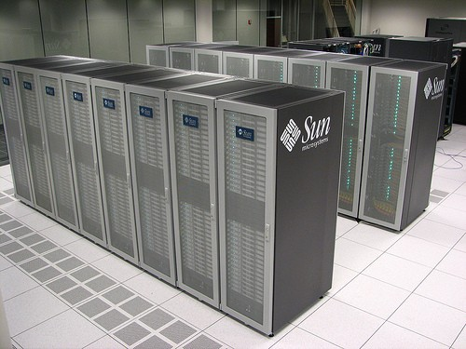
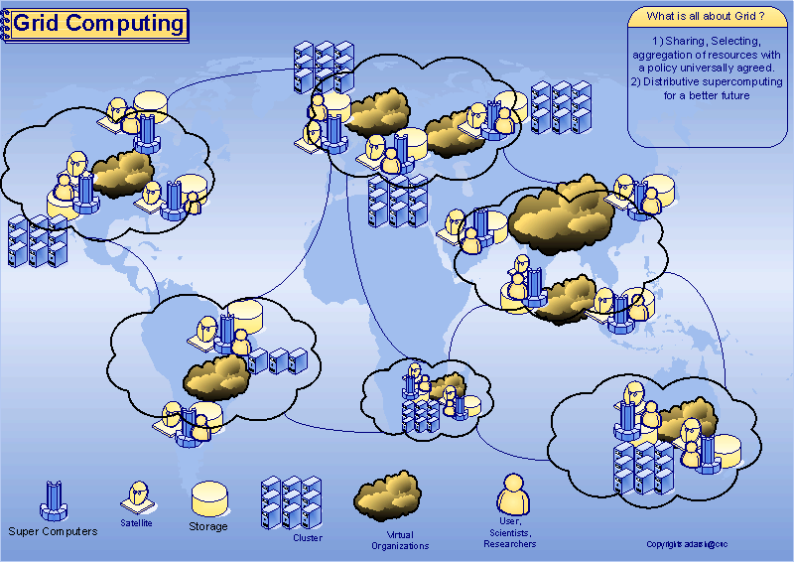
Two categories of Distributed Systems
Cluster Computing
Grid Computing
Since ~1987
A cluster usually have better performance and availability and more cost‐effectiveness over single computer with same capabilities.
Characteristics:
tightly coupled computers
single system image
centralized Job management & scheduling system
Originated early 1990s
A grid is a collection of resources owned by multiple organizations that is coordinated to allow them to solve a common problem.
Characteristics:
loosely coupled
no Single System Image
distributed Job Management & scheduling

Slide 20
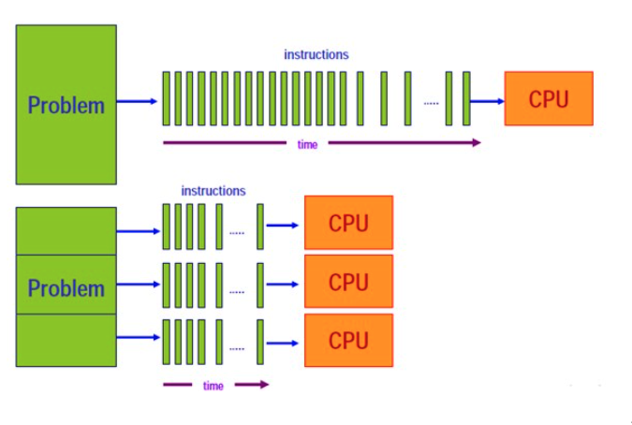
Computing Paradigms (5): Parallel Computing
In parallel computing, calculations of large problems are divided into smaller parts and carried out simultaneously/concurrently on different processors.
Characterized by:
Shared memory to exchange information
between processors.

Slide 21
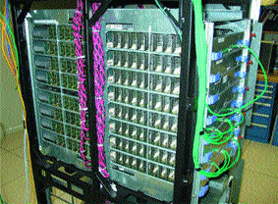
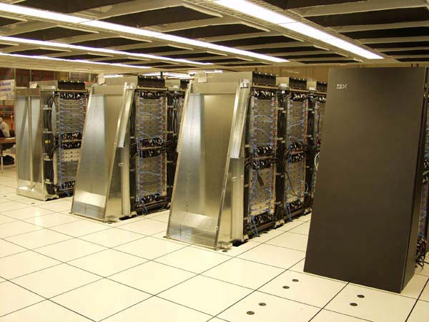
Computing Paradigms (6): Super Computing
Carnegie Mellon
Thousands of processors
Used for compute‐intensive problems
Days instead of Years!!!
Introduced in the 1960s

Slide 22
Blue Group
Carnegie Mellon
Parallel Computing
Super Computing
Could be
Cluster Computing
Distributed Computing
Grid
Computing

Slide 23
Existing Computing Paradigms
Carnegie Mellon
Personal
Super
Computing
Computing
Grid
Computing
Cluster
Parallel
Computing
Computing
Utility
Computing
Distributed
Cloud
Computing
Pervasive
Computing
Ubiquitous
Computing
Computing
Mobile
Computing

Slide 24




Computing Paradigms (7): Utility Computing
Carnegie Mellon
Water, gas, and electricity are provided to every home and business as commodity services
You get connected to the utility companies’ “public” infrastructure
You get these utility services on‐demand
And you pay‐as‐you use: charges for specific usage rather than a flat rate.
Utility Computing is doing same for computing resources (processing power, bandwidth, data storage, and enterprise software services)
Thought of by 1960s but re‐surfaced late 90s
“If computers of the kind I have advocated become the computers of the future, then computing may someday be organized as a public utility just as the telephone system is a public utility... The computer utility could become the basis of a new and important industry.„
John McCarthy, MIT Centennial in 1961

Slide 25
History of Utility Computing
IBM and other mainframe providers conducted this kind of business, often referred to as time-sharing, offering computing power and database storage to banks and other large organizations from their worldwide data centers.
To facilitate this business model, mainframe operating systems evolved to include process control facilities, security, and user metering.
Notes:
Source: https://en.wikipedia.org/wiki/Utility_computing

Slide 26
Computing Paradigms (8): Cloud Computing
Think of it as Internet Computing in which computations are done over the internet
Using someone else’s computers.
The delivery of computing resources as a service, meaning that the resources are owned and managed by the cloud provider rather than the end user.
Enabled through:
High bandwidth and high-speed Internet
Utility Computing
Virtualization

Slide 27
Cloud computing is a continuation of a long-term shift in how computing resources are managed
Third Wave
Managed service
Completely elastic storage, processing, and machine learning so that you can invest your energy in great apps. Pay for what you use.
Second Wave
Data centers (colocation)
You pay for the hardware but rent the space. Still yours to manage.
1980s
2006
2000
2009
First Wave
Server on-premises
You own everything. It’s yours to manage.
First Generation Cloud
Virtualized data centers
You rent hardware and space, but still control and configure virtual machines. Pay for what you provision.
Copyright Google LLC. For educational purposes in accordance with the terms of use set forth on the program Website.
Notes:
Cloud computing is essentially the continuation of a model where you get to rent out computing infrastructure and have it managed by dedicated professionals. Equinix and CenturyLink are two of the largest data center providers in the US. They aren’t exactly household names though. So, why are Amazon, Google, and Microsoft even in this business? In particular, why is Google doing Cloud?
The concept of cloud computing began with colocation. Instead of operating your own data center, you rented space in a colocation facility. This was the first wave of outsourcing IT. With colocation, the transfer of ownership was minimal: you still owned the machines and you maintained them. Traditionally, colocation is not thought of as cloud computing, but it did begin the process of transferring IT infrastructure out of your organization. Organizations saved money with colocation by not having to build the datacenter and the associated services. The colocation provider would simply rent all of this out to your organization.
Next, cloud computing involved virtualized data centers—virtual machines and APIs. Virtualization provides elasticity. You automate infrastructure procurement instead of purchasing hardware. With virtualization, you still maintain the infrastructure. It’s still a user-controlled/user-configured environment. This is the same as an on-premises data center, but now, the hardware is in a different location.
The next wave of cloud computing was to a fully automated, elastic cloud. This involved a move from user-maintained infrastructure to automated services. In a fully automated environment, developers don’t think about individual machines. The service automatically provisions and configures the infrastructure used to run your applications.
Google was uniquely positioned to propel organizations into this next wave of cloud computing. But what does Google have to do with Cloud?

Slide 28
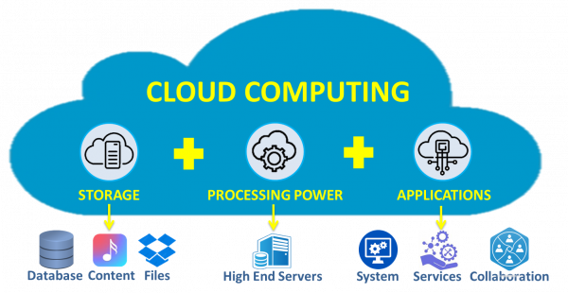
Amazon Definition of Cloud Computing
Cloud computing is the on-demand delivery of IT resources over the Internet with pay-as-you-go pricing.
Instead of buying, owning, and maintaining physical data centers and servers, you can access technology services, such as computing power, storage, and databases, on an as-needed basis from a cloud provider like Amazon Web Services (AWS).
Notes:
https://aws.amazon.com/what-is-cloud-computing/
Cloud computing is the on-demand delivery of IT resources over the Internet with pay-as-you-go pricing. Instead of buying, owning, and maintaining physical data centers and servers, you can access technology services, such as computing power, storage, and databases, on an as-needed basis from a cloud provider like Amazon Web Services (AWS).

Slide 29
What is a cloud?
It’s a cluster
It’s a supercomputer
It’s a data store
None of the above
All of the above
Cloud = Lots of storage + computer cycles near by.

Slide 30
Short video explaining Cloud Computing
Provider-independent Cloud Computing (3 minutes)
https://www.youtube.com/watch?v=a0jfeP_WBms
Provided by InfoClipz videos: Information Technology explained in 3 minutes or less

Slide 31
What can we use clouds for?
Data storage
Data processing
Arbitrary computation or data intensive tasks
machine learning
Serving web traffic
Hosting software/services

Slide 32
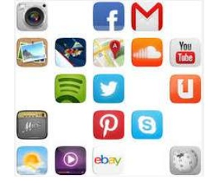
Do you currently use cloud computing?
The following services are considered cloud services:
Google Docs
Dropbox
GitHub
Skype

Slide 33
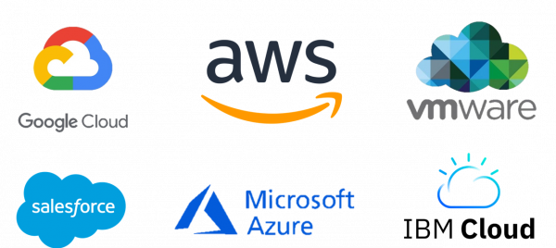
Major Cloud Service Providers

Slide 34
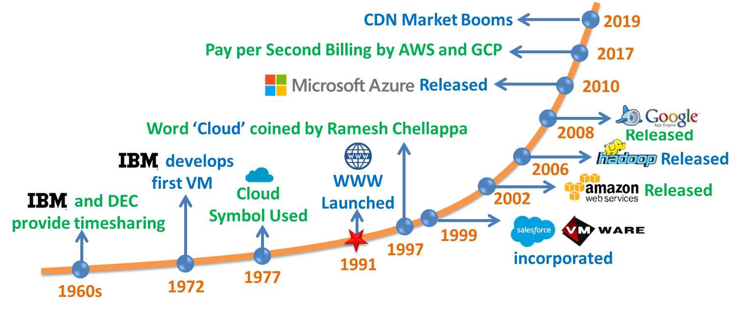
Cloud Computing History
Notes:
https://www.simplycoding.in/cloud-computing/

Slide 35
Motivation for Cloud Computing
Massive amounts of data
Limitations of local compute resources
1GB dataset can be processed by your laptop, but what about 1 petabyte.
Scalability
Every month your data scales by 2x. What now?
Availability
Your customers / clients want 99.99% uptime
Distribution
Availability in multiple geographic regions

Slide 36
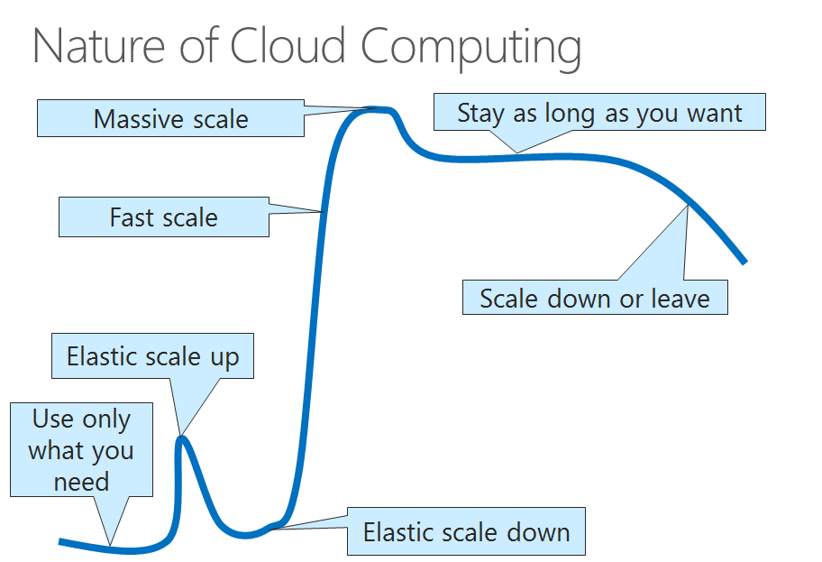
Benefits of using Cloud Computing

Slide 37
Topics covered in ICS 432
Basic concepts in the field of distributed computing, including distributed operating systems and distributed programming models.
Study of cloud computing and its enabling technologies and main building blocks.
Hands-on experience through projects utilizing public cloud infrastructures including:
Amazon Web Services (AWS), and
Google Cloud Platform (GCP).

Slide 38
Topics covered in ICS 432 (continued)
Cloud Computing Topics:
Security & Networking in the cloud
Compute in the cloud
Storage in the cloud
Cloud Databases (relational and NoSQL)
Web services and APIs
Containers
Auto scaling
Theoretical Background:
Operating Systems
Distributed Systems
Virtualization
Cloud Computing concepts
Provider-independent Concepts
AWS Cloud: AWS Academy Cloud Foundations course
GCP cloud: Google Cloud Computing Foundations Course

Slide 39
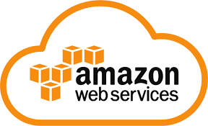
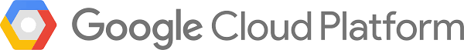
Hands-on Practice in ICS 432
We will practice the Cloud Computing Concepts using the two major cloud provided
Amazon Web Services (AWS)
Google Cloud Platform (GCP)

Slide 40
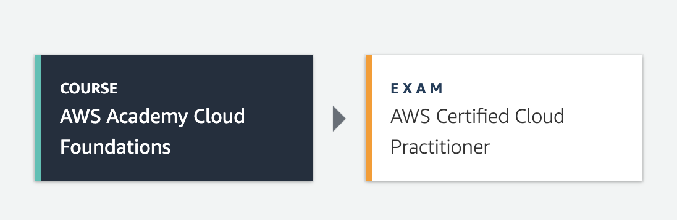
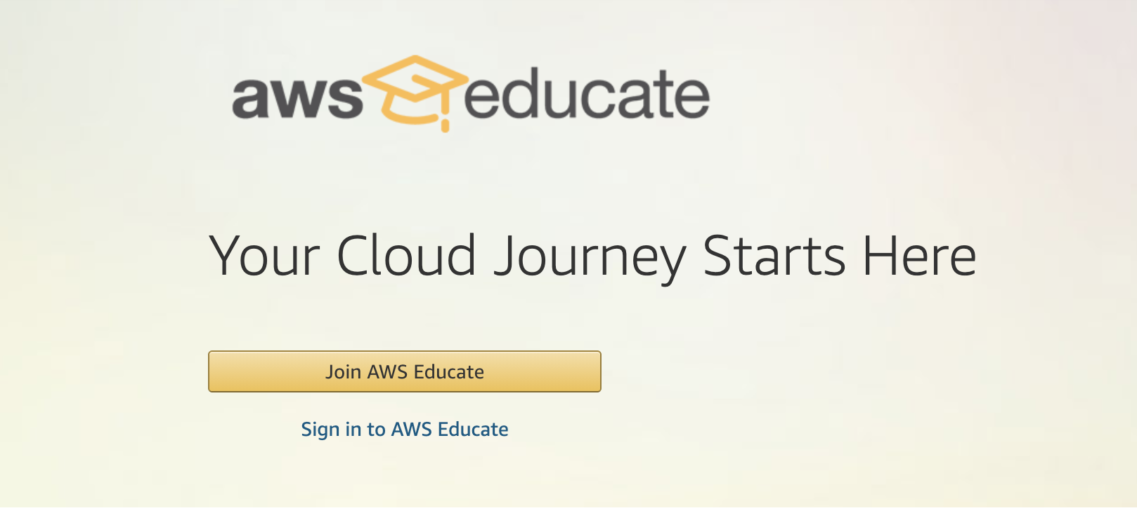
AWS Educate & AWS Academy
We will use the following AWS resources:
AWS Academy Cloud Foundations Course
course contents (including power point slides and labs) are provided to certified instructors by AWS Academy.
AWS Educate
You will be given $50 credits to use for the labs and assignments.

Slide 41
Google Cloud Platform
Google Cloud Computing Foundations Course
Course slides and labs are provided to instructors
Qwiklabs:
https://www.qwiklabs.com/
You will be given credits to use for any class assignments.
You can apply to get your 200 credits to use to practice using cloud services.
Google Cloud Console: http://console.cloud.google.com
Each student will receive $50 credits to use in labs and homework assignments.

Slide 42
Your AWS and GCP Accounts
Two documents are posted on D2L with step-to-step instructions on how to activate your AWS and GCP accounts.
Use your @metrostate.edu email address to create the accounts.
At the beginning of each lab or homework, make sure to use the class account and not your personal account (especially on GCP to avoid charges on your personal google account’s credit card).
Do not use the class credits in any projects out of the scope of ICS432.
DO NOT ENTER YOUR CREDIT CARD DETAILS.

Slide 43
Today’s Topics
Introduction to the course
Course Syllabus – You are required to carefully read the whole syllabus
Introduction to Cloud Computing

Slide 44
Reading Assignments
There is no textbook to purchase for this course.
Weekly readings will be assigned from several online resources including (but nor limited to) the following books. More books are listed in the course syllabus.
Mastering Cloud Computing (MCC).
Cloud Computing: Concepts, Technology & Architecture (CCC).
Cloud computing for Science and Engineering (CCSE).
Operating Systems Concepts, 9th Edition (OSC).
Distributed Systems, 3rd Edition (version 3.03) (DS).
Virtualization Essentials, 2nd Edition (VE).

Slide 45
Prerequisites
ICS 311 – Database Management Systems

Slide 46
Learning Outcomes
A student will know, understand, or be able to demonstrate the following:
recall and explain the fundamental concepts of distributed computing including distributed operating systems, distributed file systems, and design principles of computer clusters.
identify and compare virtualization structures and tools, CPU, memory, and I/O virtualization techniques
explain and give examples of the motivations behind cloud computing, the evolution of the paradigm, its applicability, benefits, as well as current and future challenges.

Slide 47
Learning Outcomes (continued)
define and illustrate the basic principles in data center design; cloud management techniques and cloud software deployment considerations.
experiment and differentiate cloud storage technologies and relevant distributed file systems, NoSQL databases and object Storage.
use and contrast different cloud programming models including MapReduce and Spark.
experiment and compare the programming support of major cloud service providers including Google Cloud Platform (GCP), Amazon Web Services (AWS), and Microsoft Azure.

Slide 48
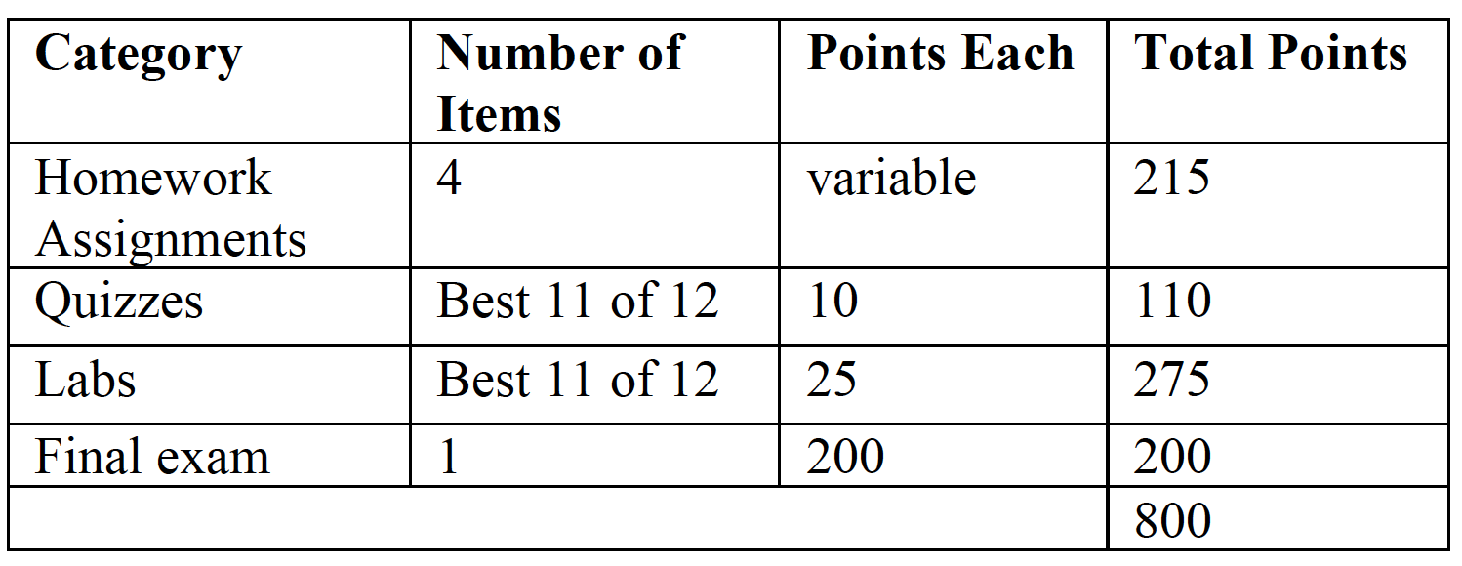
Grading Criterion
Your grade in the course will be based on points allocated to different learning activities as indicated by the table below:

Slide 49
Grade Scale
Your letter grade will be determined based on the percentage of possible points that you earn during the semester.
The following table relates the percentage to a letter grade:

Slide 50
S/N Grade Option
If you have selected the S/N grading option, then to receive a satisfactory rating (S) you must earn at least 70% of the possible points.
If you wish to elect S/N grading, you must inform the registrar before the second class meeting unless otherwise announced by the University due to COVID-19 pandemic.
Bear in mind that you must earn a C- or better (or an S) in order for a course to fulfill a requirement or elective in your major.

Slide 51
Homework Assignments
There will be four (4) Homework Assignments.
Assignments involve writing code (in Python) and/or implementing projects using AWS and GCP cloud services.
Assignments are to be done individually → subject to Academic Integrity Policy
Subject to Late Work Policy
I will select a random number of students each week to discuss their homework submission.
The goal of this discussion is to make sure that you understand the work you submitted.
Based on the discussion, your homework grade may be affected either positively or negatively.

Slide 52
Homework Submission
Each homework assignment will include submission instructions and due date.
The due date is usually a Friday.
Assignments are to be uploaded to the designated D2L folder by 11:59 PM of the due date.
DO NOT MISS CLASS IN ORDER TO WORK ON A PROGRAM. This can only make you fall further behind.

Slide 53
Quizzes
There will be a quiz in every class session except on the day of the final exam.
A total of 12 quizzes will be administered and your quiz with lowest grade will be dropped.
Each quiz is 20~30 minutes long and will be on D2L.
The quiz may be administered at any time during the class period.
I will NOT provide make up quizzes.
A quiz will not include any question on the topics covered in the same day as the quiz.

Slide 54
Exams
There is a comprehensive final exam on the last class session from 9:00 AM to 12:20 PM on December 11, 2021.
The final exam will be online administered on D2L.

Slide 55
Attendance
For all ICS courses, participation must occur during the first week of class or the student is dropped from the course.
You are expected attend all class sessions.
If you miss a class, you will lose the points for that week’s quiz.
If you miss a class, it is your responsibility to Keep up with the assigned readings and homework.
Federal Financial Aid regulations require that the University track ongoing attendance. I will keep a record of your class participation based on attending the weekly class meeting and completing the weekly labs and quizzes.

Slide 56
Late Work Policy
Each student is granted:
one late lab submission (up to three days) without penalty.
one late homework submission (up to three days) without penalty.
After the first late submission, any other submission will incur a 10% per day penalty for up to three days.
Any submission that is more than three days late will receive a grade of ZERO.
I encourage you to talk to me if you have unavoidable circumstances.

Slide 57
What You Can Expect From Me
Show up to teach class as scheduled.
Treat you with respect.
Do my work to the best of my ability.
Grade your work and give you feedback in a reasonably prompt manner.

Slide 58
What I Expect From You
Attend class regularly.
Ensure that you have the necessary prerequisites for taking the class (i.e., ICS 311).
Be respectful of me and your classmates.
Seek help (talk to or email me) if you are having difficulty with your course work.
You are responsible for everything we cover in class whether you were in class or absent.

Slide 59
What I Expect From You (Continued)
Turn in individual and original work.
Please be respectful of copyrights and document your sources appropriately.
This means that what you turn in must be your own work and it cannot be copied from work previously done for some other class(es).
If you copy a snippet of code from a book or an online source, you should cite the source in comments in your code. Otherwise, you have committed plagiarism.
Say no if another student asks you for a copy of your work.
The penalty for permitting another student to copy your work is the same as if you yourself had turned in work that was not individual and original.

Slide 60
Academic Integrity Policy
All homework assignments, labs, quizzes, and exams are to be done individually.
Violations:
Cheating
Intentionally using or attempting to use unauthorized materials, information, or study aids in any work submitted for credit
Plagiarism
The adoption or reproduction of ideas or words or statements of another person as one's own without acknowledgment.
You also must formally acknowledge the written source from which you took the material. (This includes material taken from the World Wide Web and other Internet sources.)
For further information, you can locate the full policy and procedure at:
Policy: https://www.metrostate.edu/about/policies/7081
Procedure: https://www.metrostate.edu/about/policies/7156

Slide 61
Academic Integrity Procedure: First-Level Violation
A violation may be considered first-level if the violation affects a small proportion of the course’s overall grade or would not have increased a student’s grade in the course significantly.
Examples of first-level violations include but are not limited to:
unauthorized collaboration on a homework assignment or lab.
copying from another student during a quiz or examination.
using unauthorized materials during an exam.

Slide 62
Academic Integrity Procedure: Second-Level Violation
Second-level violations are serious breaches of academic integrity.
These violations involve premeditated dishonesty or repeated ethics violations and result in disciplinary procedures.
Examples of second-level violations include, but are not limited to:
committing a second first-level violation
acquiring or distributing an exam answer key from an unauthorized source
making unauthorized copies of examination materials

Slide 63
Academic Integrity Procedure: Sanctions
First-level violations:
Assignment of zero in the assignment for all students involved.
Provost/Vice President of Academic Affairs will send the student a Breach of Academic Integrity Letter informing the student about the violation of the Academic Integrity Policy and the action(s) taken by the instructor.
Second-level violation:
assigning disciplinary failure (F) for the course.
sending the student a copy of Breach of Academic Integrity Letter documenting the student’s academic integrity policy violation, history of violations (if applicable), and disciplinary action(s) taken by the instructor.

Slide 64
Drop and Withdrawal Deadlines
Last date to drop with full refund: Friday, August 27, 2021 at 11:59 PM.
Last date to withdraw: Monday, November 22, 2021 (No refund)
Available at the University Calendar web site:
https://www.metrostate.edu/academics/calendar/fall-2021

Slide 65
Disability Services
Metropolitan State University offers accommodations to qualified students with documented disabilities.
If you have a disability that may require accommodations, it is essential that you be registered with the Center for Accessibility Resources.
Note that I must receive official letter from Disability Services office in order to honor requests.
Contacts for the Center for Accessibility Resources.
Center for Accessibility Resources
Founders Hall, Room 146 A, St. Paul Campus
Phone: 651-793-1549,
TTY: 651-772-7581
Email: disability.Services@metrostate.edu.

Slide 66
Today’s Topics
Introduction to the course
Course Syllabus
Introduction to Cloud Computing

Slide 67
Introduction to Cloud Computing
Provider-independent Introduction to Cloud Computing
Reading:
CCC: Chapter 3: Understanding Cloud Computing (pages 38 - 49)
MCC: Chapter 1:
Introduction
AWS Cloud
AWS Cloud Foundations course:
Module 1: Cloud Concepts Overview
GCP Cloud
Google Cloud Computing Foundations Course:
Module 1: So, what us the cloud anyway

Slide 68
Provider-independent Introduction to Cloud Computing

Slide 69
Reading
Lecture slides (week-01-cloudcomputingintro)
Cloud Computing: Concepts, Technology & Architecture: Chapter 3
Authors: Thomas Erl, Ricardo Puttini, and Zaigham Mahmood
Chapter 3 available at this link. Pages: 38-63
Mastering Cloud Computing (MCC): Chapter 1
Authors: Rajkumar Buyya, Christian Vecchiola, S. Thamarai Selvi
Metro State Library provides unlimited access to this book at this link. Log in using your StarID.
The National Institute of Standards and Technology (NIST) definition of Cloud Computing
https://nvlpubs.nist.gov/nistpubs/Legacy/SP/nistspecialpublication800-145.pdf

Slide 70
Provider-independent Introduction to Cloud Computing
Cloud computing: Terminology, Benefits & Risks
Cloud Deployment Modes (public, private, community, hybrid)
Cloud Computing Characteristics
Cloud Service Models (Iaas, PaaS, SaaS)

Slide 71
Provider-independent Introduction to Cloud Computing
Cloud Computing: Terminology, Benefits & Risks
Cloud Deployment Modes (public, private, community, hybrid)
Cloud Computing Characteristics
Cloud Service Models (Iaas, PaaS, SaaS)

Slide 72
National Institute of Standards and Technology (NIST) Definition of Cloud Computing
Cloud computing is a model for enabling ubiquitous, convenient, on-demand network access to a shared pool of configurable computing resources (e.g., networks, servers, storage, applications, and services) that can be rapidly provisioned and released with minimal management effort or service provider interaction.
This cloud model is composed of five essential characteristics, three service models, and four deployment models
Notes:
NIST: National Institute of Standards and Technology
https://nvlpubs.nist.gov/nistpubs/Legacy/SP/nistspecialpublication800-145.pdf

Slide 73
5 essential characteristics
3 service models
4 deployment models
On-demand self-service
Broad network access
Resource pooling
Rapid elasticity
Measured service
SaaS: Software as a Service
PaaS: Platform as a Service
IaaS: Infrastructure as a Service
Public cloud
Private cloud
Hybrid cloud
Community cloud

Slide 74
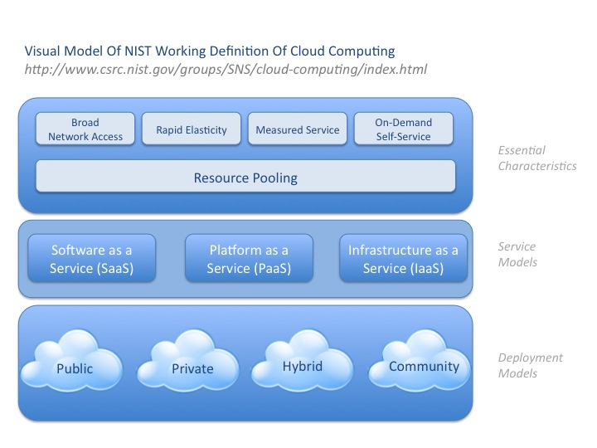

Slide 75
Basic Concepts and Terminology
Cloud
IT Resource
On-premise
Cloud consumers and Cloud providers
Scaling
Cloud Service
Service-Level Agreement (SLA)

Slide 76
Basic Concepts and Terminology (1/4)
1. Cloud: A cloud refers to an IT environment that is designed for purpose of remotely provisioning scalable measured IT resources.
2. IT resource: a physical or virtual IT-related artifact that can be either
software-based (e.g., a virtual server or a software program) or
hardware-based (e.g., a physical server or network device).
3. On-premise: an IT resource that is hosted in a conventional IT enterprise with an organizational boundary (i.e., not cloud-based).

Slide 77
Basic Concepts and Terminology (2/4)
4. Cloud provider: the party that provides cloud-based IT resources
Cloud consumer: the party that uses cloud-based IT resources.
5. Scaling: the ability of the IT resource to handle increased or decreased usage demands. There are two types:
Horizontal Scaling (scaling out and scaling in):
allocation and releasing of IT resources of the same type.
Vertical scaling (scaling up and scaling down):
IT resource is replaced by another with higher or lower capacity.

Slide 78
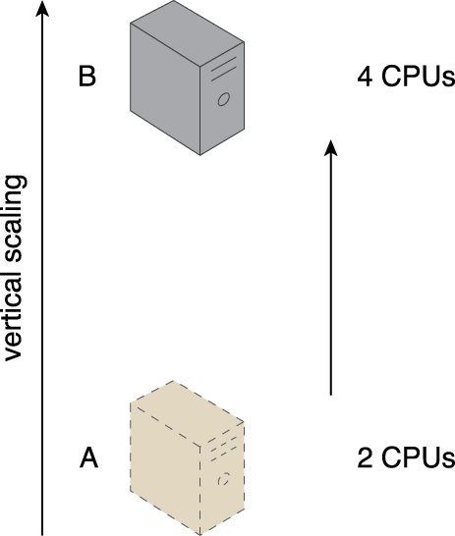
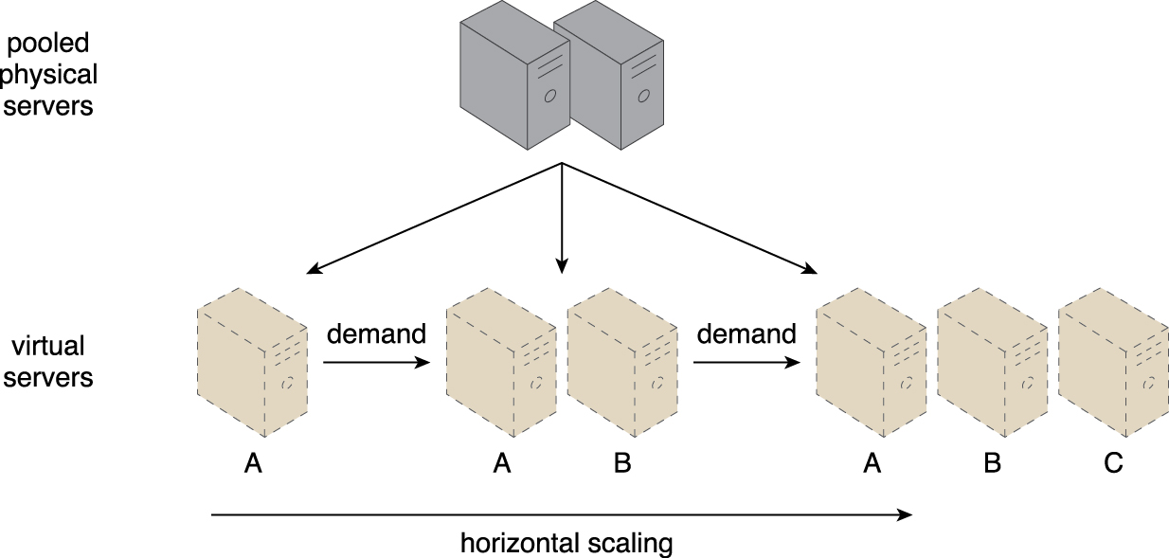
Scaling illustrated
Notes:
Figure: From Cloud Computing by Thomas Erl, Zaigham Mahmood, and Ricardo Puttini
(ISBN: 0133387526) Copyright © 2013 Arcitura Education, Inc. All rights reserved.

Slide 79
Horizontal vs. Vertical Scaling

Slide 80
Basic Concepts and Terminology (3/4): Cloud Service
6. Cloud Service: any IT resource that is made remotely accessible via a cloud.

Slide 81
Basic Concepts and Terminology (4/4): Service-Level Agreement (SLA)
7. Service-Level Agreement (SLA) is the human-readable part of a service contract between a cloud provider and cloud consumer that describes
Quality of Service (QoS) features
behaviors
limitations of a cloud-based service or other provisions.
Since the implementation of a service is hidden from the cloud consumer, an SLA becomes a critical specification.

Slide 82
NIST Cloud Computing Reference Architecture

Slide 83
Notes:
https://bigdatawg.nist.gov/_uploadfiles/M0008_v1_7256814129.pdf

Slide 84
Cloud Computing Services

Slide 85
Goals and Benefits of Cloud Computing
Reduced Investments and Proportional costs
reduction (or elimination) of up-front IT investments, namely hardware and software purchased and ownership costs.
Increased Scalability
clouds empowers cloud consumers to scale their cloud-based IT resources to accommodate processing fluctuations and peaks automatically or manually.
Increased Availability and Reliability
Outages limit the time an IT resource can be “open for business” for its customers, thereby limiting its usage and revenue generating potential.
Although many cloud environments are capable of offering remarkably high levels of availability and reliability, it comes down to the guarantees made in the SLA that typically represent their actual contractual obligations.

Slide 86
Risks and Challenges of Cloud Computing
Increased Security Vulnerabilities
Reduced Operational Governance Control
Limited portability between cloud providers
Multi-regional Compliance and legal issues.

Slide 87
Risks and Challenges of Cloud Computing (1/3)
Increased Security Vulnerabilities
the remote usage of IT resources requires an expansion of trust boundaries by the cloud consumer to include the external cloud.
The overlapping of trust boundaries and the increased exposure of data can provide malicious cloud consumers (human and automated) with greater opportunities to attack IT resources and steal or damage business data

Slide 88
Risks and Challenges of Cloud Computing (2/3)
Limited portability between cloud providers
Due to a lack of established industry standards within the cloud computing industry, public clouds are commonly proprietary to various extents.
For cloud consumers that have custom-built solutions with dependencies on these proprietary environments, it can be challenging to move from one cloud provider to another.

Slide 89
Risks and Challenges of Cloud Computing (3/3)
Reduced Operational Governance Control
Cloud consumers are usually allotted a level of governance control that is lower than that over on-premise IT resources.
Legal contracts, when combined with SLAs, technology inspections, and monitoring, can mitigate governance risks and issues.
Multi-regional Compliance and legal issues.
Third-party cloud providers will frequently establish data centers in affordable or convenient geographical locations.
Cloud consumers will often not be aware of the physical location of their IT resources and data when hosted by public clouds.
For some organizations, this can pose serious legal concerns pertaining to industry or government regulations that specify data privacy and storage policies.

Slide 90
Powerful features of public clouds
Public clouds operates at a scale far larger than any private cloud, and hence they offer a broad set of powerful features:
elasticity
find-grained billing
higher reliability due to geographic distribution
wide variety of resource types
rich set of platform services
Economics of scale

Slide 91
Video summarizing Pros and Cons of Cloud computing
On Premise vs Cloud Computing – Prose and Cons Comparison (4 minutes)
https://www.youtube.com/watch?v=KVydGQGR1Lo

Slide 92
Businesses save time and money by moving to the cloud (1/2)
Dave power, Associate Information Consultant at Eli Lilly: “With AWS, a new server can be up and running in three minutes (it used to take Eli Lilly seven and a half week to deploy a server internally) and a 64-node Linux cluster can be online in five minutes (compared with three months internally).”
Ingo Elfering, Vice President of Information Technology Strategy, GlaxoSmithKline: “With online services, we are able to reduce our operational costs by roughly 30% of what we were spending”
Notes:
Eli Lilly & GlaxoSmithKline are pharmaceutical companies
:

Slide 93
Businesses save time and money by moving to the cloud (2/2)
Jim Swartz, CIO, Sybase: “At Sybase, a private cloud of virtual servers inside its data center has saved nearly $2 million annually since 2006, because the company can share computing power and storage resources across servers”
Hundreds of startups in Silicon Valley can harness large computing resources without buying their own machines.
Notes:
Sybase is a data management company: enterprise software and services company that produced software to manage and analyze information in relational databases

Slide 94
Cloud Business Drivers
Capacity Planning
Organizational Agility
Cost Reduction

Slide 95
Cloud Business Drivers (1/3): Capacity Planning
Capacity planning is the process of determining and fulfilling future demands of an organization’s IT resources, products, and services.
Capacity: the maximum amount of work that an IT resource is capable of delivering in a given period of time.
The discrepancy between the capacity of an IT resource and its demand can result in a system being either
inefficient (over-provisioning)
unable to fulfill user needs (under-provisioning)
Capacity planning is focused on minimizing this discrepancy to achieve predictable efficiency and performance.
Notes:
discrepancy: the state or quality of being discrepant or in disagreement, as by displaying an unexpected or unacceptable difference; inconsistency:

Slide 96
Capacity Planning (continued)
Different capacity planning strategies exist:
lead strategy: adding capacity in anticipating of demand.
lag strategy: adding capacity when the IT resource reaches it full capacity
Match strategy: adding IT resource capacity in small increments, as demand increases.
Capacity planning can be challenging because it requires estimating usage load fluctuations
balance peak usage requirements without unnecessary over-expenditure on infrastructure

Slide 97
Cloud Business Drivers (2/3): Organizational Agility
Organizational agility is the measure of an organization’s responsiveness to change:
change caused by both internal and external factors.
Change can be by changing IT resources beyond the scope of what was previously predicted or planned for.
Changing business needs and priorities may require IT resources to be more available and reliable than before.

Slide 98
Cloud Business Drivers (3/3): Cost Reduction
Two costs need to be accounted for in an IT environment:
the cost of acquiring new infrastructure
the cost if its ongoing ownership
Operational overhead represents a considerable share of IT budgets
technical personnel
upgrades and patches
utility bills
administrative and accounts staff
An IT department can become a significant drain of the business

Slide 99
Economics of Clouds
Two basic categories of clouds:
Public clouds that provide service to any paying customer
Private clouds that are accessible only to company employees
If you are staring a new service/company: should you use a public cloud or purchase your own private cloud?

Slide 100

Cloud Economics

Slide 101
Single site: Outsource or Own?
Consider a medium-sized organization:
needs a service for M months
Service requires 128 servers (1024 cores) and 524 TB
Outsource (e.g., via AWS): monthly cost
S3 costs: $0.12/GB/month.
Storage: $0.12*524*1000 ~$62K/month
EC2 costs: $0.10 per CPU hour (costs from 2009)
$0.1 * 1024 * 24 * 30 ~ $136 K/month
Own: monthly cost
Storage ~$349 K
Total ~ $1555 K /month + $7.5 K (includes 1 sysadmin/100 nodes)

Slide 102
Single site: Outsource or Own?
Breakeven analysis:
More preferable to own if:
$349 K/M < $62 K (storage)
$1555 K/ M + 7.5K < $136 k (overall)
Breakeven points:
M > 5.55 months (storage)
M > 12 months (overall)
As a result
Startups use clouds a lot
Cloud providers benefits monetarily from storage.

Slide 103
Elasticity: Shifting the Risk
Cloud Computing’s ability to add or remove resources at a fine grain (one server at a time with Amazon’s EC2) and with a lead time of minutes rather than weeks allows matching resources to workload much more closely.
Real world estimates of server utilization in datacenters range from 5% to 20%. Users provision for the peak and allow the resources to remain idle at nonpeak times. The more pronounced the variation, the more the waste.
Even if peak load can be correctly anticipated, without elasticity we waste resources during nonpeak times.
Notes:
Real world estimates of server utilization in datacenters range from 5% to 20%.
This may sound shockingly low, but it is consistent with the observation that for many services the peak
workload exceeds the average by factors of 2 to 10.

Slide 104
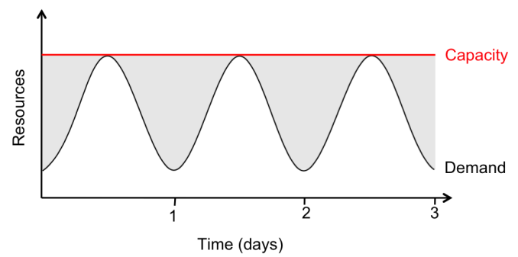
Elasticity: Shifting the Risk (continued)
Pay by use instead of provisioning for the peak (leads to underutilization of resources)
Even if service operators predict the spike sizes correctly, capacity is wasted; and if they overestimate the spike they provision for, it’s even worse.
Notes:
Service peak daily demand at noon requires 500 servers and service tough daily demand requires 100 servers.
The average utilization over a whole day is 300 servers. So the actual utilization over the whole day is 300 * 24 = 7200 server-hours.
But since we must provision to the peak of 500 servers, we pay for 500 * 24 = 12000 server-hours, a factor of 1.7 more than what is needed.
In fact, the above example underestimates the benefits of elasticity, because in addition to simple diurnal patterns,
most nontrivial services also experience seasonal or other periodic demand variation (e.g., e-commerce peaks in December
and photo sharing sites peak after holidays) as well as some unexpected demand bursts due to external events
(e.g., news events). Since it can take weeks to acquire and rack new equipment, the only way to handle such spikes
is to provision for them in advance.

Slide 105
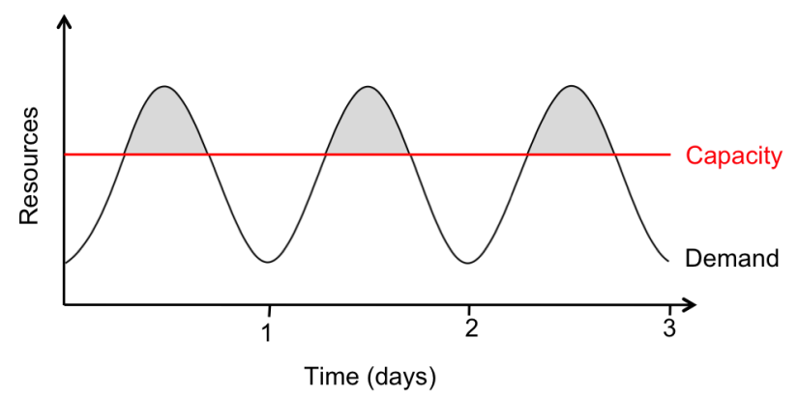
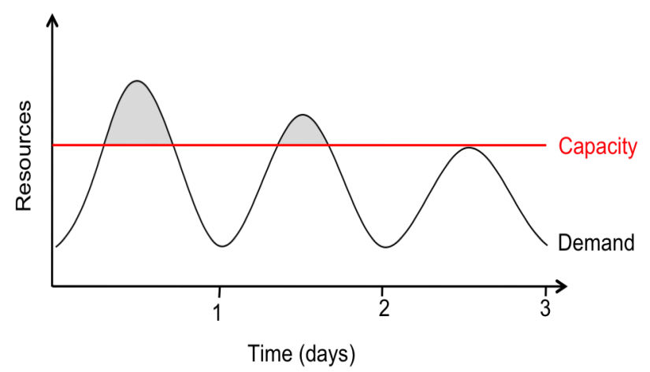
Elasticity: Shifting the Risk (continued)
Service operators also underestimate the spike, however, accidentally turning away excess users. Not only do rejected users generate zero revenue, they may never come back due to poor service.
Users will desert an under-provisioned service until the peak user load equals the datacenter’s usable capacity, at which point users again receive acceptable service, but with fewer potential users.
Notes:
While the monetary effects of over-provisioning are easily measured, those of under-provisioning are harder to measure yet potentially equally serious.

Slide 106
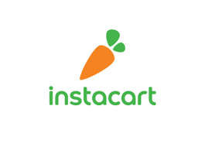
AWS Case Study: Instacart
https://aws.amazon.com/solutions/case-studies/instacart/
5-minutes video
Notes:
More case studies can be found in: https://aws.amazon.com/economics/

Slide 107
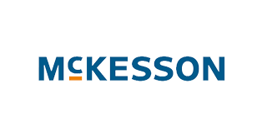
GCP Case Study: McKesson
https://cloud.google.com/customers
2-minutes video

Slide 108
Provider-independent Introduction to Cloud Computing
Cloud computing: Terminology, Benefits & Risks
Cloud Deployment Modes (public, private, community, hybrid)
Cloud Computing Characteristics
Cloud Service Models (Iaas, PaaS, SaaS)

Slide 109
5 essential characteristics
3 service models
4 deployment models
On-demand self-service
Broad network access
Resource pooling
Rapid elasticity
Measured service
SaaS: Software as a Service
PaaS: Platform as a Service
IaaS: Infrastructure as a Service
Public cloud
Private cloud
Hybrid cloud
Community cloud

Slide 110
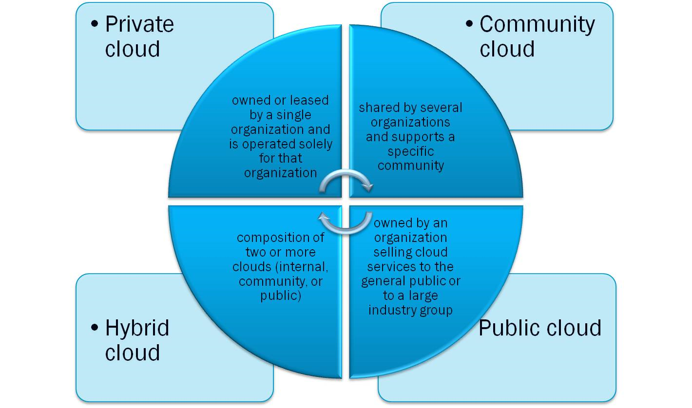
Cloud Deployment Models

Slide 111
Four Cloud Deployment Models
1. Public Cloud:
Utility computing: computing is delivered in a way similar to electricity, water, and sewer
Example providers:
AWS: Amazon Web Services
GCP: Google Cloud Platform
2.Private Cloud:
operated by a private institution
provides storage and computing only to the institution’s employees
preferred when the workloads contain sensitive data that should not leave the premises.

Slide 112
Four Cloud Deployment Models (continued)
3. Hybrid Cloud:
an organization may use a hybrid cloud architecture that utilizes both a private and public cloud
selected tasks are run on public clouds
4. Community cloud:
a private deployment designed to support a specific community
Examples: a set of companies or academic institutions who want to share resources.

Slide 113
Four Cloud Deployment Models

Slide 114
Provider-independent Introduction to Cloud Computing
Cloud computing: Terminology, Benefits & Risks
Cloud Deployment Modes (public, private, community, hybrid)
Cloud Computing Characteristics
Cloud Service Models (Iaas, PaaS, SaaS)

Slide 115





Cloud computing has five fundamental characteristics
On-demand self-service
Broad network access
Resource pooling
Rapid
elasticity
Measured service
No human intervention needed to get resources
Access from anywhere
Provider shares resources to consumers
Get more resources quickly as needed
Pay only for what you consume
Copyright Google LLC. For educational purposes in accordance with the terms of use set forth on the program Website.
Notes:
Cloud computing has five fundamental characteristics:
First, computing resources are on-demand and self-service. Cloud-computing customers use an automated interface and get the processing power, storage, and network they need, without the typical complex configurations required when building physical servers.
Second, resources are accessible over a network from any location.
Providers allocate resources to consumers from a large pool, allowing them to benefit from economies of scale. The resources exist in multiple locations all over the world, you just have to decide the available geographic location you wish to utilize.
Resources are elastic. If you need more resources you can get them rapidly. And when you need less, you can scale back.
Finally, you pay only for what you use or reserve, as you go. If you stop using resources, you simply stop paying.

Slide 116
Cloud Computing Characteristics (1/5) On-demand self-service Usage
A cloud consumer can unliaterally access and self-provision cloud-based IT resources.
Once configured, usage of the resources can be automated, requiring no further human involvement by the cloud user or cloud provider.
Notes:
unilaterally: involving, done by, or decided by only one person, side, party, or faction.

Slide 117
Cloud Computing Characteristics (2/5) Broad Network access
Ubiquitous access represents the ability for a cloud service to be widely accessible.
Requires support for
a range of devices
transport protocols
interfaces
security technologies

Slide 118
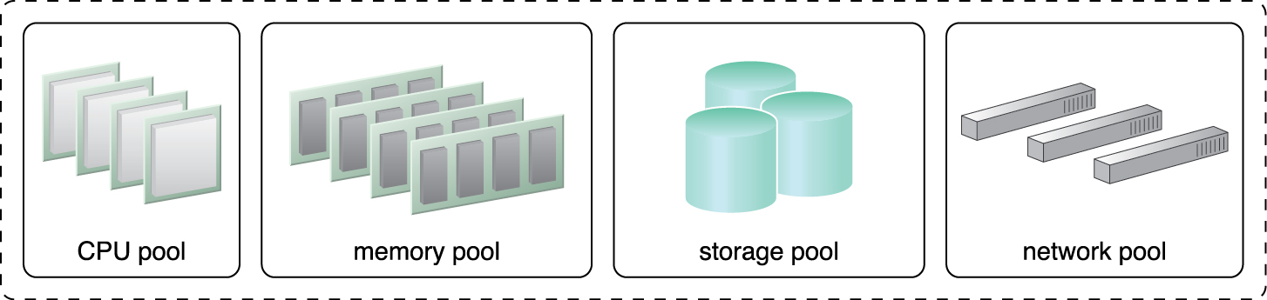
Cloud Computing Characteristics (3/5) Resource Pooling
A resource pooling architecture is based on the use of one or more resource pools, in which identical IT resources are grouped and maintained by a system that automatically ensures that they remain synchronized.
Physical and virtual resources dynamically assigned and reassigned according to consumer demand.

Slide 119
Resource Pooling (continued)
the provider’s computing resources are pooled to serve multiple consumers using the multi-tenant model.
Location-independence: customer has no control or knowledge over the exact location of the provided resources but may be able to specify location at a higher level of abstraction (e.g., country, state, or data center).

Slide 120
Cloud Computing Characteristics (4/5) Rapid Elasticity
Rapid Elasticity is the automated ability of a cloud to transparently scale IT resources as required in response to runtime conditions or a pre-determined by the cloud consumer or cloud provider.
Capabilities can be elastically provisioned and released, in some cases automatically, to scale rapidly outward and inward commensurate with demand.
To the customer, the capabilities available for provisioning often appear to be unlimited and can be appropriated in any quantity at any time.

Slide 121
Cloud Computing Characteristics (5/5) Measured Usage
The measured usage characteristic is related to on-demand usage.
It represents the ability of a cloud platform to keep track of the usage of its IT resources.
Based on what is measured, the cloud provider can charge the consumer only for:
the IT resources actually used and/or
the timeframe during which access to the IT resources was granted.

Slide 122
Provider-independent Introduction to Cloud Computing
Cloud computing: Terminology, Benefits & Risks
Cloud Deployment Modes (public, private, community, hybrid)
Cloud Computing Characteristics
Cloud Service Models (Iaas, PaaS, SaaS)

Slide 123
Videos
IaaS vs PaaS vs SaaS (7 minutes)
https://www.youtube.com/watch?v=36zducUX16w
SaaS (2.5 minutes)
http://www.youtube.com/watch?v=kGUPSvswmY0&feat ure=related

Slide 124
Cloud Delivery Models: *aaS Classification
IaaS: Infrastructure as a service
On-demand servers, Amazon EC2, VMWare, vClound
Paas: Platform as a Service
On-demand application-hosting environment
For example, Google App Engine, Salesforce.com, Windows Azure, Amazon
SaaS: Software as a Service
on-demand applications
For example, Gmail, Microsoft Office Web Campanions.

Slide 125
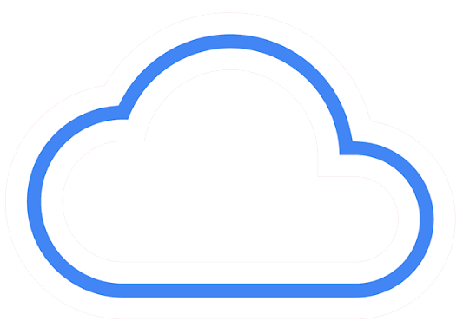
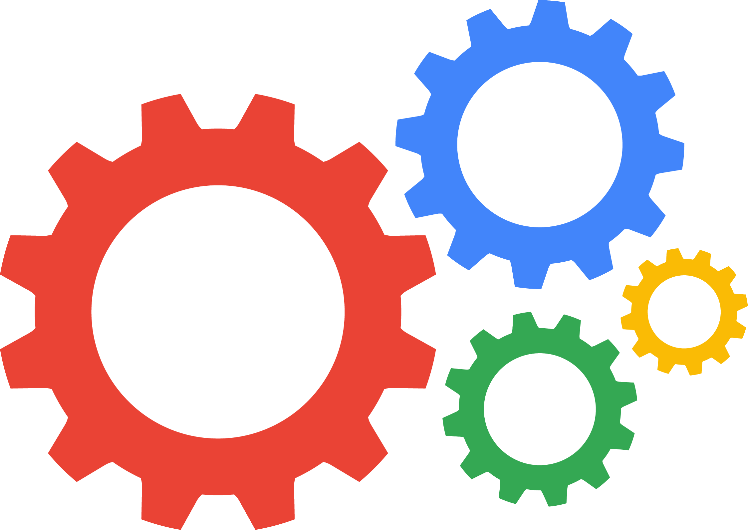


IaaS versus PaaS versus SaaS
Infrastructure as a service
(IaaS)
Platform as a service
(PaaS)
Software as a service
(SaaS)
CPU, memory, storage, and networking is provided as a service.
The user needs to manage the OS and the application.
The platform is a managed service.
All the user provides is the application.
The platform and software is provided as a service to the user.
The user supplies the data.
Copyright Google LLC. For educational purposes in accordance with the terms of use set forth on the program Website.
Notes:
With infrastructure as a service, the service provides the underlying architecture for you to run servers. The resources to run are provided, but it’s up to the user to manage the operating system and application.
Platform as a service takes it one step further. Now the entire environment will be managed for you the user, and all that is required of you is to manage your applications. The operating system layer will be managed as part of the service.
For Software as a service, the infrastructure, platform, and software is managed for you. All that’s required is that you bring your data to the system. A few commercial examples of SaaS include SAP and Salesforce.

Slide 126
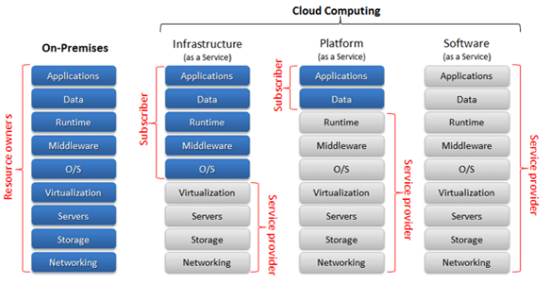
Iaas, Paas, SaaS comparison
Notes:
what you see is it really matters what you contribute as the client towards the operations of the system, is to which one of those IaaS, PaaS, SaaS, you actually fit into. So these different diagrams show you how much involvement you get, and what you can do. And of course, associated with each of these is a degree of flexibility about what you can actually do.
So, in the packaged software, where you're sort of providing everything, you manage the whole of the system.
And in the infrastructure as a system (Iaas), that's decreased and what you're doing is getting from the provider the bottom level, that pink level, virtualization services storage network. And you're having to manage the application's data runtime, middleware, and operating system.
If you move to a platform as a service (Paas), then this extends and you get the operating system, middleware, runtime. You only have to manage the applications and data as a service. Or the applications and data in your service.
If you go to a software as a service (SaaS) then it's all managed for you by the vendor. And the applications what's provided to the client, and so
the client doesn't have to manage anything.

Slide 127
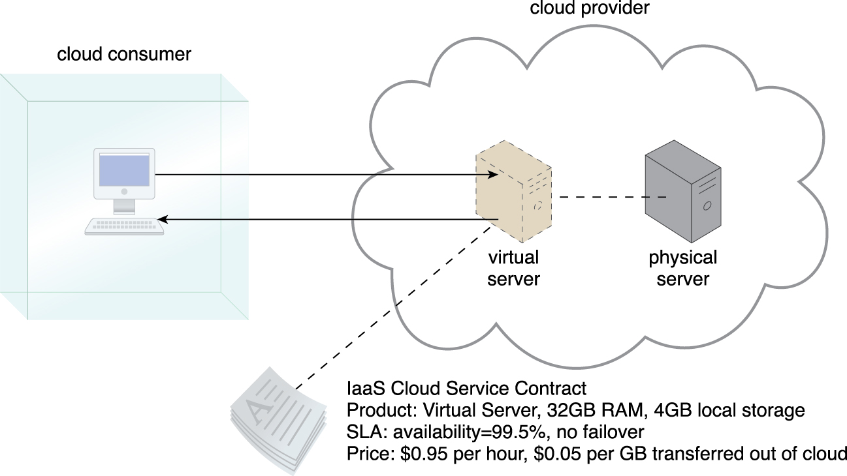
IaaS : Infrastructure as a Service
Figure 4.11 A cloud consumer is using a virtual server within an IaaS environment. Cloud consumers are
provided with a range of contractual guarantees by the cloud provider, pertaining to characteristics
such as capacity, performance, and availability.
Notes:
Figure:

Slide 128
NIST definition of IaaS
The capability provided to the consumer is to provision processing, storage, networks, and other fundamental computing resources where the consumer is able to deploy and run arbitrary software, which can include operating systems and applications. The consumer does not manage or control the underlying cloud infrastructure but has control over operating systems, storage, and deployed applications; and possibly limited control of select networking components (e.g., host firewalls).

Slide 129
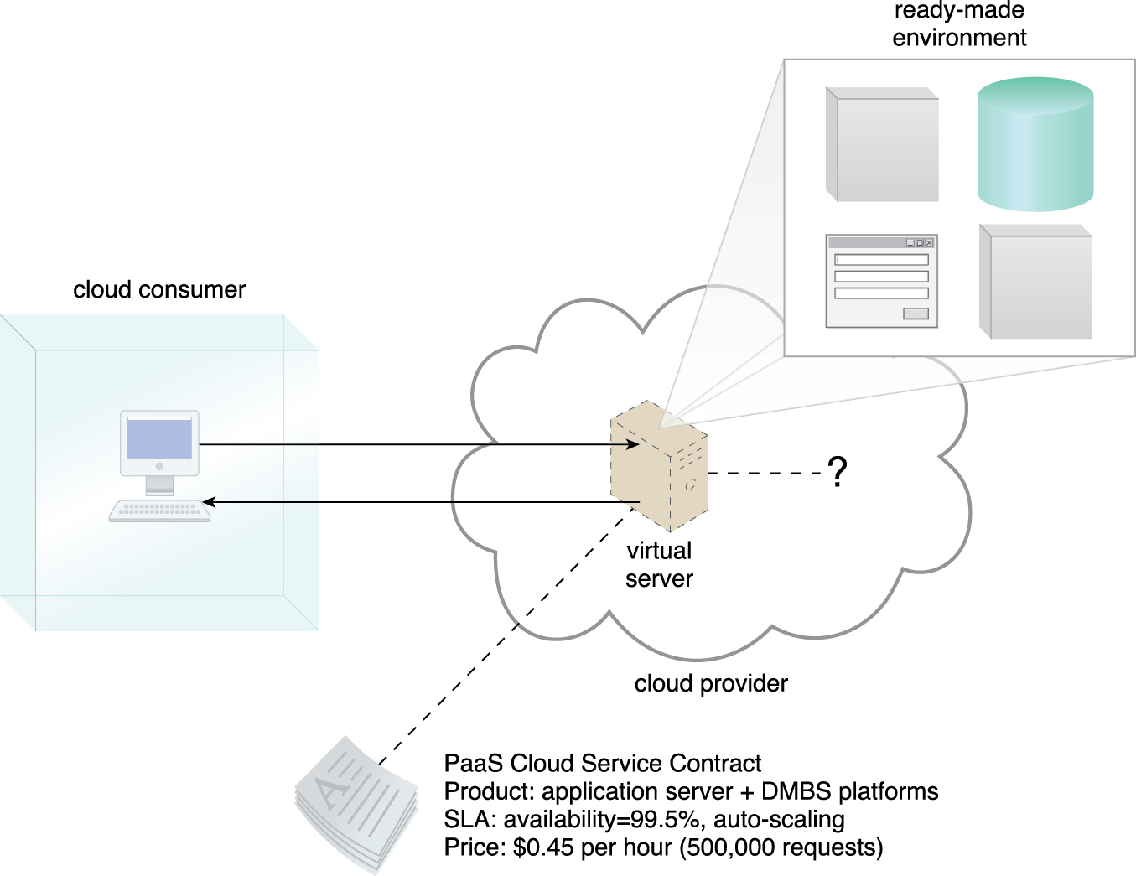
PaaS : Platform as a Service
PaaS is a cloud computing service that offers a platform for users to run applications on the cloud.
A cloud consumer is accessing a ready-made PaaS environment. The question mark indicates that the cloud consumer is intentionally shielded from the implementation details of the platform

Slide 130
PaaS (continued)
PaaS is a level above IaaS:
unlike IaaS, PaaS does not require users to develop their own operating system environment.
PaaS is a middle ground between IaaS and SaaS.
PaaS provides a development platform platform that will automatically scale with demand.
Customers use it to develop applications that benefit from the scalability of the Cloud without fully developing their own solution using an IaaS provider.

Slide 131
NIST definition of PaaS
The capability provided to the consumer is to deploy onto the cloud infrastructure consumer-created or acquired applications created using programming languages, libraries, services, and tools supported by the provider. The consumer does not manage or control the underlying cloud infrastructure including network, servers, operating systems, or storage, but has control over the deployed applications and possibly configuration settings for the application-hosting environment.

Slide 132
PaaS Examples
Amazon AWS EC2
Google App Engine
Microsoft Azure:
Compute: Web, worker, and VM role
Storage: Blob, table, Queue, and Azure SQL Server
Application fabric:
Services bus, access control
Future: cache, integration, and composite.

Slide 133
Advantages of PaaS
PaaS is more cost effective than IaaS because systems are optimized to run applications efficiently.
IaaS may only provide hardware, and thus, client must be in charge of load balancing and networking.

Slide 134
Disadvantage of PaaS
Vendor lock-in
PaaS may lock in applications by requiring users to develop apps using proprietary interfaces and languages.
This means that is may be difficult for users to go to another vendor to host their app.
Businesses may risk their future on the dependability of the PaaS.

Slide 135
As a developer, IaaS or PaaS?
As a developer, your objective is to create an application in the quickest most effective way possible.
You should not create applications using convoluted methods that may take a long time to complete.
The user only sees the end product, not the development process.

Slide 136
PaaS vs. IaaS
When you use the Cloud, remember that your decisions have long-term consequences.
If you choose to use a PaaS and get your application vendor locked in, then your business may fail if the PaaS greatly increases the vendor’s prices.
You will not be able to move to another cloud since your app cannot be easily migrated to somewhere else.

Slide 137
PaaS vs. IaaS (continued)
An app that is used to fulfill a temporary need may be handled by a PaaS solution.
An app that needs to be deployed quickly may be faster developed by a PaaS.
If your software team is small, it may be better to develop a PaaS and let the PaaS provider handle the OS and networking for you.

Slide 138
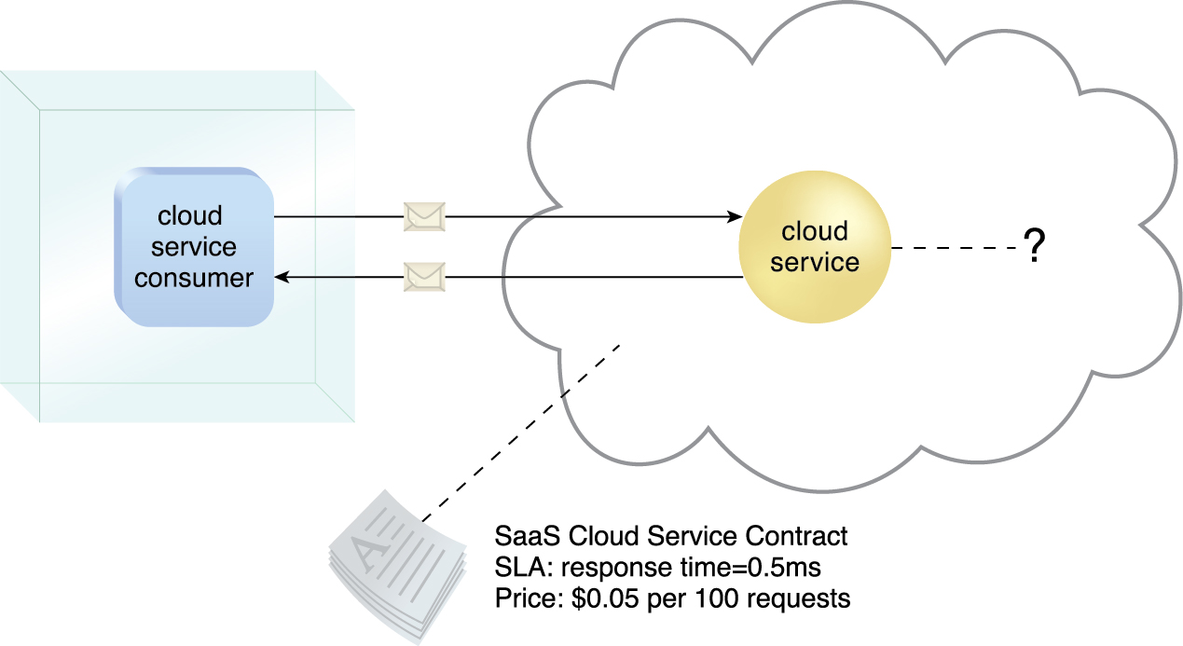
SaaS: Software as a Service
A software program positioned as a shared cloud service and made available as a
‘product’ or a generic utility.
A cloud consumer is granted very limited administrative control over a SaaS implementation.

Slide 139
NIST definition of SaaS
The capability provided to the consumer is to use the provider’s applications running on a cloud infrastructure. The applications are accessible from various client devices through either a thin client interface, such as a web browser (e.g., web-based email), or a program interface. The consumer does not manage or control the underlying cloud infrastructure including network, servers, operating systems, storage, or even individual application capabilities, with the possible exception of limited user-specific application configuration
Notes:
https://csrc.nist.gov/glossary/term/Software_as_a_Service

Slide 140
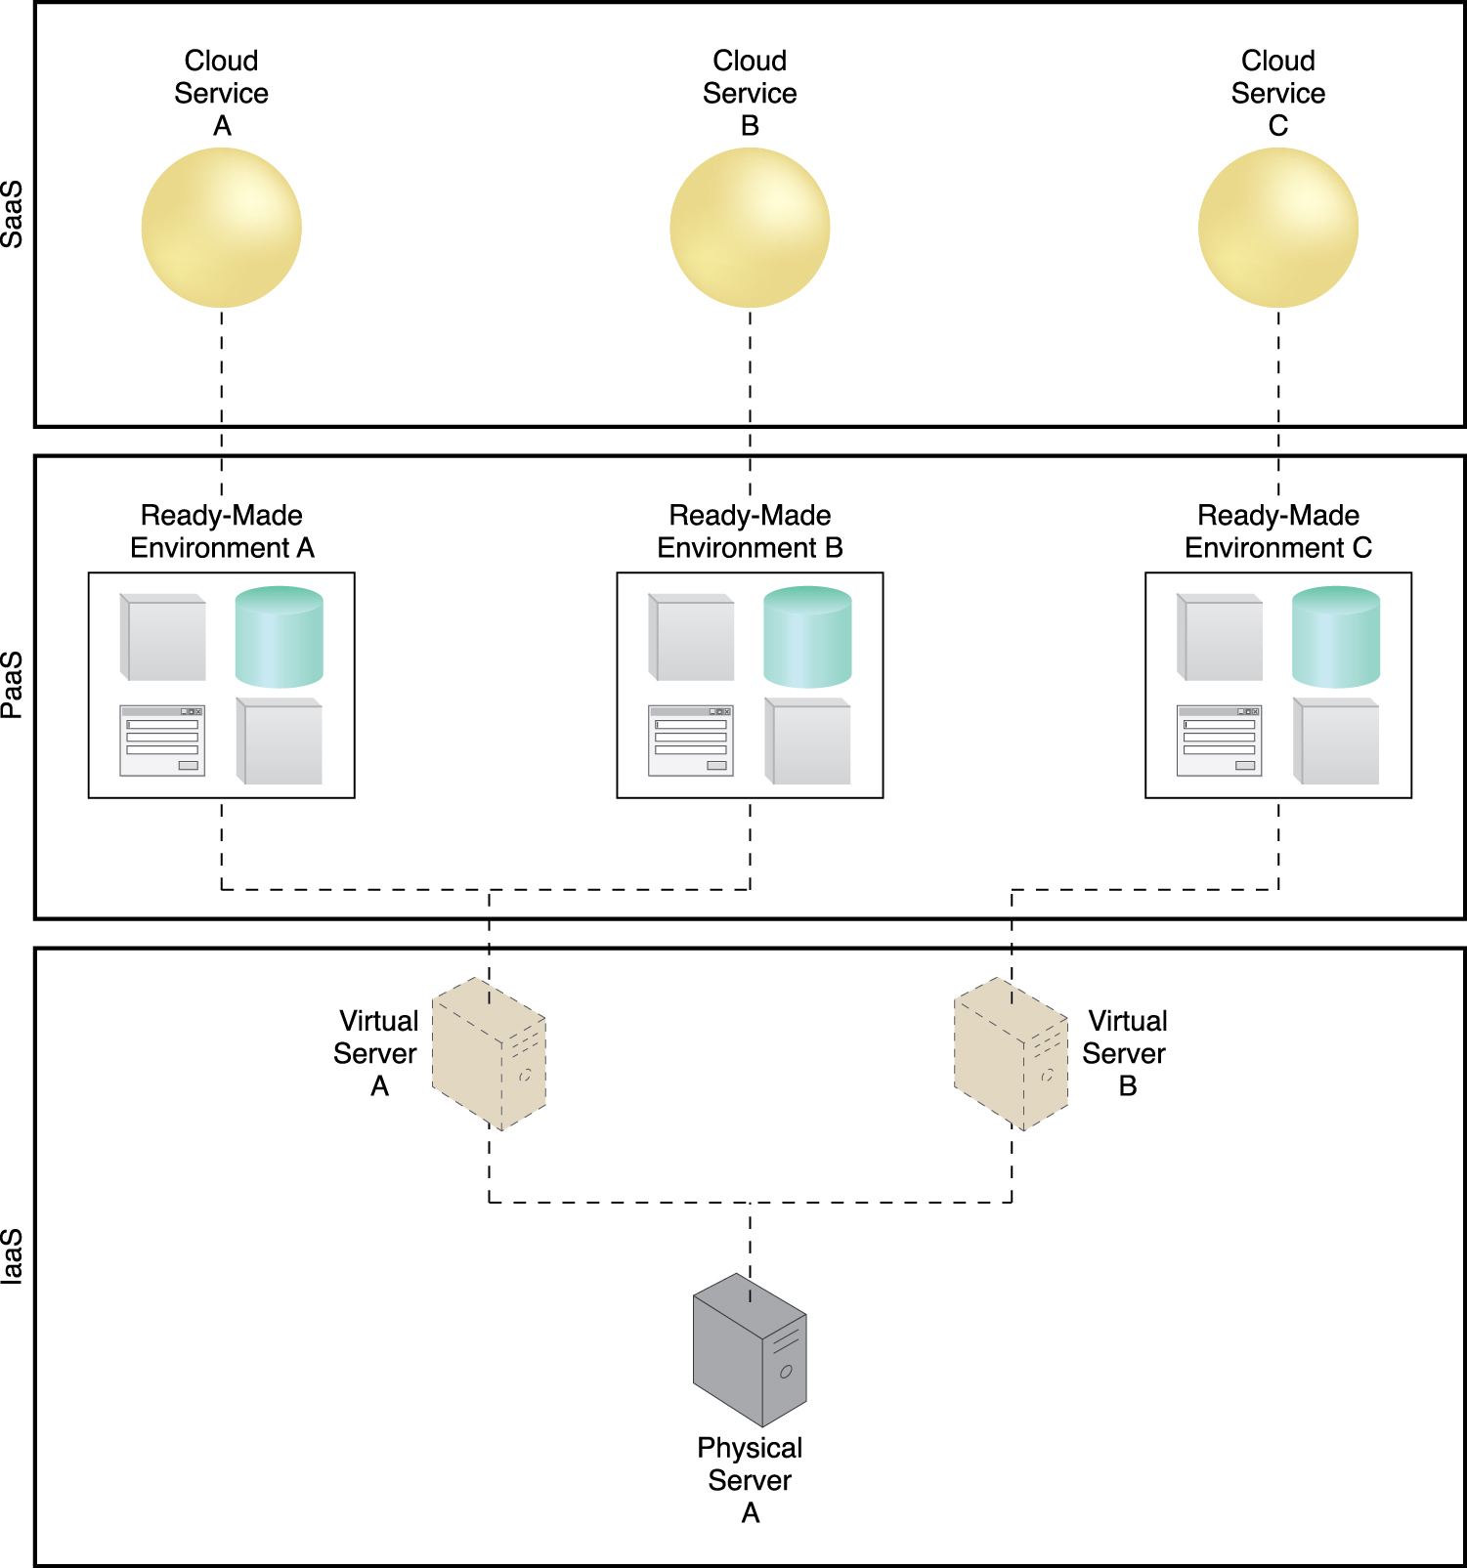
A simple layered view of an architecture comprised of IaaS and PaaS environments hosting three SaaS cloud service implementations

Slide 141
Summary of Cloud Computing Concepts
Terminology: SLA, cloud provide, cloud consumer, multi-tenant
Benefits: reduced cost, scalability, availability, and reliability.
Risks: security, less governance, limited portability, multi-region
Business drivers: capacity planning, organizational agility, cost reduction
Economics of Scale
Characteristics: on-demand, network access, resource pooling, elasicity
Service Models: IaaS, PaaS, and SaaS

Slide 142
Part 2: AWS Academy Cloud Foundations Course
Module 1: Cloud Concepts Overview

Slide 143
Module 1: Cloud Concepts Overview
AWS Academy Cloud Foundations
© 2019 Amazon Web Services, Inc. or its Affiliates. All rights reserved.
Notes:
Welcome to Module 1: Cloud Concepts Overview.

Slide 144
Module overview
Topics
Introduction to cloud computing
Advantages of cloud computing
Introduction to Amazon Web Services (AWS)
AWS Cloud Adoption Framework (AWS CAF)
Notes:
This module addresses the following topics:
Introduction to cloud computing
Advantages of cloud computing
Introduction to Amazon Web Services (AWS)
AWS Cloud Adoption Framework (AWS CAF)
Finally, you will be asked to complete a knowledge check that will be used to test your understanding of the key concepts that are covered in this module.

Slide 145
Module objectives
After completing this module, you should be able to:
Define different types of cloud computing models
Describe six advantages of cloud computing
Recognize the main AWS service categories and core services
Review the AWS Cloud Adoption Framework (AWS CAF)
Notes:
After completing this module, you should be able to:
Define different types of cloud computing
Describe six advantages of cloud computing
Recognize the main AWS service categories and core services
Review the AWS Cloud Adoption Framework (AWS CAF)

Slide 146
Section 1: Introduction to cloud computing
Module 1: Cloud Concepts Overview
Notes:
Section 1: Introduction to cloud computing

Slide 147
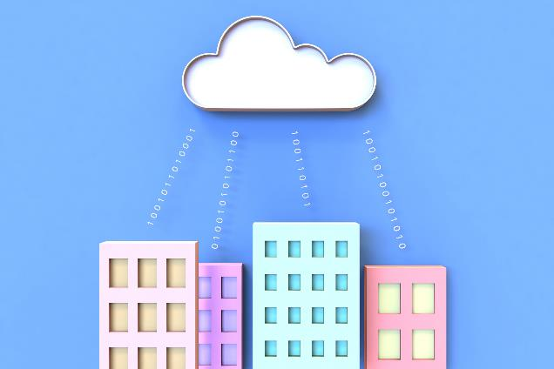
What is cloud computing?
Notes:
What does cloud computing mean to you?
Take a moment to think of what cloud computing means to you and write a short sentence.

Slide 148
Cloud computing defined
Cloud computing is the on-demand delivery of compute power, database, storage, applications, and other IT resources via the internet with pay-as-you-go pricing.
Notes:
Cloud computing is the on-demand delivery of compute power, database, storage, applications, and other IT resources via the internet with pay-as-you-go pricing. These resources run on server computers that are located in large data centers in different locations around the world. When you use a cloud service provider like AWS, that service provider owns the computers that you are using. These resources can be used together like building blocks to build solutions that help meet business goals and satisfy technology requirements.
To learn more about cloud computing and how it works, see this AWS webpage.

Slide 149
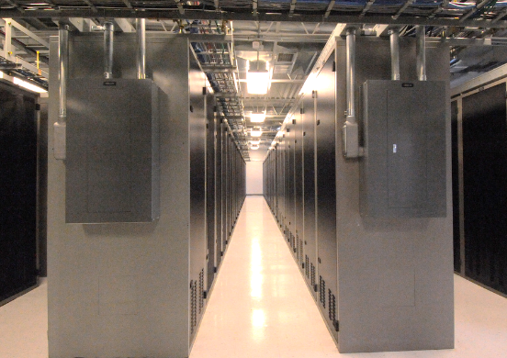

Infrastructure as software
Cloud computing enables you to stop thinking of your infrastructure as hardware, and instead think of (and use) it as software.
Notes:
Cloud computing enables you to stop thinking of your infrastructure as hardware, and instead think of (and use) it as software. But what does this mean?

Slide 150
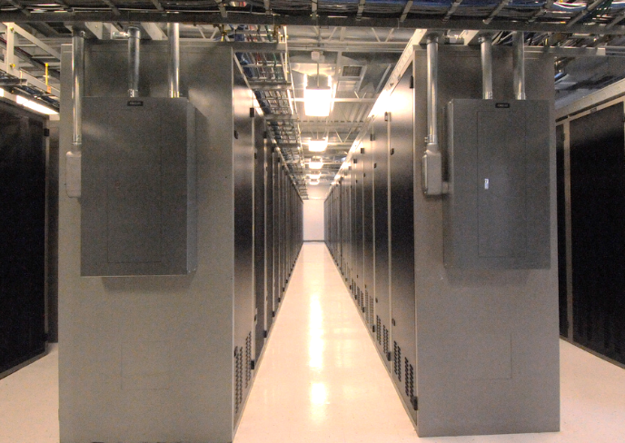
Traditional computing model
Infrastructure as hardware
Hardware solutions:
Require space, staff, physical security, planning, capital expenditure
Have a long hardware procurement cycle
Require you to provision capacity by guessing theoretical maximum peaks
Notes:
In the traditional computing model, infrastructure is thought of as hardware. Hardware solutions are physical, which means they require space, staff, physical security, planning, and capital expenditure.
In addition to significant upfront investment, another prohibitive aspect of traditional computing is the long hardware procurement cycle that involves acquiring, provisioning, and maintaining on-premises infrastructure.
With a hardware solution, you must ask if there is enough resource capacity or sufficient storage to meet your needs, and you provision capacity by guessing theoretical maximum peaks. If you don’t meet your projected maximum peak, then you pay for expensive resources that stay idle. If you exceed your projected maximum peak, then you don’t have sufficient capacity to meet your needs. And if your needs change, then you must spend the time, effort, and money required to implement a new solution.
For example, if you wanted to provision a new website, you would need to buy the hardware, rack and stack it, put it in a data center, and then manage it or have someone else manage it. This approach is expensive and time-consuming.

Slide 151

Cloud computing model
Infrastructure as software
Software solutions:
Are flexible
Can change more quickly, easily, and cost-effectively than hardware solutions
Eliminate the undifferentiated heavy-lifting tasks
Notes:
By contrast, cloud computing enables you to think of your infrastructure as software. Software solutions are flexible. You can select the cloud services that best match your needs, provision and terminate those resources on-demand, and pay for what you use. You can elastically scale resources up and down in an automated fashion. With the cloud computing model, you can treat resources as temporary and disposable. The flexibility that cloud computing offers enables businesses to implement new solutions quickly and with low upfront costs.
Compared to hardware solutions, software solutions can change much more quickly, easily, and cost-effectively.
Cloud computing helps developers and IT departments avoid undifferentiated work like procurement, maintenance, and capacity planning, thus enabling them to focus on what matters most.
As cloud computing has grown in popularity, several different service models and deployment strategies have emerged to help meet the specific needs of different users. Each type of cloud service model and deployment strategy provides you with a different level of control, flexibility, and management. Understanding the differences between these cloud service models and deployment strategies can help you decide what set of services is right for your needs.

Slide 152

Cloud service models
IaaS
(infrastructure as a service)
PaaS
(platform as a service)
SaaS
(software as a service)
More control over IT resources
Less control over IT resources
Notes:
There are three main cloud service models. Each model represents a different part of the cloud computing stack and gives you a different level of control over your IT resources:
Infrastructure as a service (IaaS): Services in this category are the basic building blocks for cloud IT and typically provide you with access to networking features, computers (virtual or on dedicated hardware), and data storage space. IaaS provides you with the highest level of flexibility and management control over your IT resources. It is the most similar to existing IT resources that many IT departments and developers are familiar with today.
Platform as a service (PaaS): Services in this category reduce the need for you to manage the underlying infrastructure (usually hardware and operating systems) and enable you to focus on the deployment and management of your applications.
Software as a service (SaaS): Services in this category provide you with a completed product that the service provider runs and manages. In most cases, software as a service refers to end-user applications. With a SaaS offering, you do not have to think about how the service is maintained or how the underlying infrastructure is managed. You need to think only about how you plan to use that particular piece of software. A common example of a SaaS application is web-based email, where you can send and receive email without managing feature additions to the email product or maintaining the servers and operating systems that the email program runs on.

Slide 153
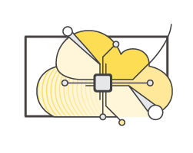
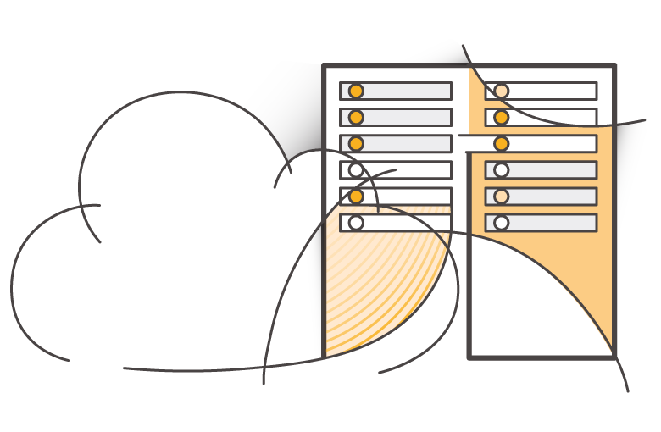
Cloud computing deployment models
Cloud
Hybrid
On-premises (private cloud)
Notes:
There are three main cloud computing deployment models, which represent the cloud environments that your applications can be deployed in:
Cloud: A cloud-based application is fully deployed in the cloud, and all parts of the application run in the cloud. Applications in the cloud have either been created in the cloud or have been migrated from an existing infrastructure to take advantage of the benefits of cloud computing. Cloud-based applications can be built on low-level infrastructure pieces or they can use higher-level services that provide abstraction from the management, architecting, and scaling requirements of core infrastructure.
Hybrid: A hybrid deployment is a way to connect infrastructure and applications between cloud-based resources and existing resources that are not located in the cloud. The most common method of hybrid deployment is between the cloud and existing on-premises infrastructure. This model enables an organization to extend and grow their infrastructure into the cloud while connecting cloud resources to internal systems.
On-premises: Deploying resources on-premises, using virtualization and resource management tools, is sometimes called private cloud. While on-premises deployment does not provide many of the benefits of cloud computing, it is sometimes sought for its ability to provide dedicated resources. In most cases, this deployment model is the same as legacy IT infrastructure, but it might also use application management and virtualization technologies to increase resource utilization.

Slide 154





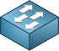

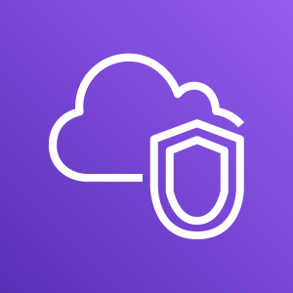



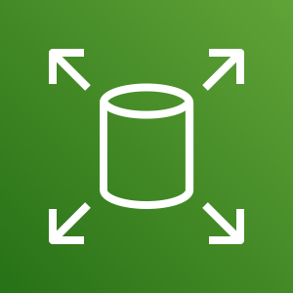
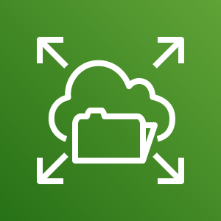

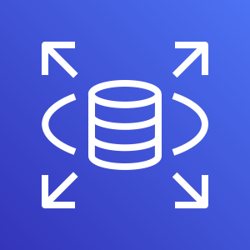


Similarities between AWS and traditional IT
Traditional, on-premises IT space
AWS
Security
Security groups
Firewalls
ACLs
Administrators
Network ACLs
IAM
Networking
Router
Network pipeline
Switch
Elastic Load Balancing
Amazon VPC
On-premises servers
Compute
AMI
Amazon EC2 instances
Storage and database
DAS
SAN
NAS
RDBMS
Amazon EBS
Amazon EFS
Amazon S3
Amazon RDS
Notes:
There are many similarities between AWS and the traditional, on-premises IT space:
AWS security groups, network access control lists (network ACLs), and AWS Identity and Access Management (IAM) are similar to firewalls, access control lists (ACLs), and administrators.
Elastic Load Balancing and Amazon Virtual Private Cloud (Amazon VPC) are similar to routers, network pipelines, and switches.
Amazon Machine Images (AMIs) and Amazon Elastic Compute Cloud (Amazon EC2) instances are similar to on-premises servers.
Amazon Elastic Block Store (Amazon EBS), Amazon Elastic File System (Amazon EFS), Amazon Simple Storage Service (Amazon S3), and Amazon Relational Database Service (Amazon RDS) are similar to direct attached storage (DAS), storage area networks (SAN), network attached storage (NAS), and a relational database management service (RDBMS).
With AWS services and features, you can do almost everything that you would want to do with a traditional data center.

Slide 155

Section 1 key takeaways
Cloud computing is the on-demand delivery of IT resources via the internet with pay-as-you-go pricing.
Cloud computing enables you to think of (and use) your infrastructure as software.
There are three cloud service models: IaaS, PaaS, and SaaS.
There are three cloud deployment models: cloud, hybrid, and on-premises or private cloud.
Almost anything you can implement with traditional IT can also be implemented as an AWS cloud computing service.
Notes:
Some key takeaways from this section of the module include:
Cloud computing is the on-demand delivery of IT resources via the internet with pay-as-you-go pricing.
Cloud computing enables you to think of (and use) your infrastructure as software.
There are three cloud service models: IaaS, PaaS, and SaaS.
There are three cloud deployment models: cloud, hybrid, and on-premises or private cloud.
There are many AWS service analogs for the traditional, on-premises IT space.

Slide 156
Section 2: Advantages of cloud computing
Module 1: Cloud Concepts Overview
Notes:
Section 2: Advantages of cloud computing
Why are so many companies interested in moving to the cloud? This section presents six advantages of cloud computing.

Slide 157


Trade capital expense for variable expense
Capital
Data center investment based on forecast
Pay only for the amount you consume
Notes:
Advantage #1—Trade capital expense for variable expense: Capital expenses (capex) are funds that a company uses to acquire, upgrade, and maintain physical assets such as property, industrial buildings, or equipment. Do you remember the data center example in the traditional computing model where you needed to rack and stack the hardware, and then manage it all? You must pay for everything in the data center whether you use it or not.
By contrast, a variable expense is an expense that the person who bears the cost can easily alter or avoid. Instead of investing heavily in data centers and servers before you know how you will use them, you can pay only when you consume resources and pay only for the amount you consume. Thus, you save money on technology. It also enables you to adapt to new applications with as much space as you need in minutes, instead of weeks or days. Maintenance is reduced, so you can spend focus more on the core goals of your business.

Slide 158




Massive economies of scale
Because of aggregate usage from all customers, AWS can achieve higher economies of scale and pass savings on to customers.
AWS Cloud
Economies of scale
Savings
Notes:
Advantage #2—Benefit from massive economies of scale: By using cloud computing, you can achieve a lower variable cost than you can get on your own. Because usage from hundreds of thousands of customers is aggregated in the cloud, providers such as AWS can achieve higher economies of scale, which translates into lower pay-as-you-go prices.

Slide 159





Stop guessing capacity
Overestimated server capacity
Underestimated server capacity
Scaling on demand
Notes:
Advantage #3—Stop guessing capacity: Eliminate guessing about your infrastructure capacity needs. When you make a capacity decision before you deploy an application, you often either have expensive idle resources or deal with limited capacity. With cloud computing, these problems go away. You can access as much or as little as you need, and scale up and down as required with only a few minutes’ notice.

Slide 160


Increase speed and agility
Launch
Weeks between wanting resources and having resources
Minutes between wanting resources and having resources
Notes:
Advantage #4—Increase speed and agility: In a cloud computing environment, new IT resources are only a click away, which means that you reduce the time it takes to make those resources available to your developers from weeks to just minutes. The result is a dramatic increase in agility for the organization because the cost and time that it takes to experiment and develop are significantly lower.

Slide 161




Stop spending money on running and maintaining data centers
Payroll …. … .. … …. … .. … …. … .. … …. … .. … …. … .. … …. … .. …
Utilities …. … .. … …. … .. … …. … .. … …. … .. … …. … .. … …. … .. …
Maintenance …. … .. … …. … .. … …. … .. … …. … .. … …. … .. … …. … .. …
Landscaping …. … .. … …. … .. … …. … .. … …. … .. … …. … .. … …. … .. …
Hardware …. … .. … …. … .. … …. … .. … …. … .. … …. … .. … …. … .. …
Investment
Running data centers
Business and customers
Notes:
Advantage #5—Stop spending money on running and maintaining data centers: Focus on projects that differentiate your business instead of focusing on the infrastructure. Cloud computing enables you to focus on your own customers instead of the heavy lifting of racking, stacking, and powering servers.

Slide 162




Go global in minutes
Notes:
Advantage #6—Go global in minutes: You can deploy your application in multiple AWS Regions around the world with just a few clicks. As a result, you can provide a lower latency and better experience for your customers simply and at minimal cost.

Slide 163
Section 2 key takeaways
Trade capital expense for variable expense
Benefit from massive economies of scale
Stop guessing capacity
Increase speed and agility
Stop spending money on running and maintaining data centers
Go global in minutes
Notes:
The key takeaways from this section of the module include the six advantages of cloud computing:
Trade capital expense for variable expense
Massive economies of scale
Stop guessing capacity
Increase speed and agility
Stop spending money on running and maintaining data centers
Go global in minutes

Slide 164
Section 3: Introduction to Amazon Web Services (AWS)
Module 1: Cloud Concepts Overview
Notes:
Section 3: Introduction to Amazon Web Services (AWS)

Slide 165



What are web services?
A web service is any piece of software that makes itself available over the internet and uses a standardized format—such as Extensible Markup Language (XML) or JavaScript Object Notation (JSON)—for the request and the response of an application programming interface (API) interaction.
Request message
Internet
Response message
Client
Web service
Notes:
In general, a web service is any piece of software that makes itself available over the internet or on private (intranet) networks. A web service uses a standardized format—such as Extensible Markup Language (XML) or JavaScript Object Notation (JSON)—for the request and the response of an application programming interface (API) interaction. It is not tied to any one operating system or programming language. It’s self-describing via an interface definition file and it is discoverable.

Slide 166
What is AWS?
AWS is a secure cloud platform that offers a broad set of global cloud-based products.
AWS provides you with on-demand access to compute, storage, network, database, and other IT resources and management tools.
AWS offers flexibility.
You pay only for the individual services you need, for as long as you use them.
AWS services work together like building blocks.
Notes:
Amazon Web Services (AWS) is a secure cloud platform that offers a broad set of global cloud-based products. Because these products are delivered over the internet, you have on-demand access to the compute, storage, network, database, and other IT resources that you might need for your projects—and the tools to manage them. You can immediately provision and launch AWS resources. The resources are ready for you to use in minutes.
AWS offers flexibility. Your AWS environment can be reconfigured and updated on demand, scaled up or down automatically to meet usage patterns and optimize spending, or shut down temporarily or permanently. The billing for AWS services becomes an operational expense instead of a capital expense.
AWS services are designed to work together to support virtually any type of application or workload. Think of these services like building blocks, which you can assemble quickly to build sophisticated, scalable solutions, and then adjust them as your needs change.

Slide 167























Categories of AWS services
Analytics
Application
Integration
AR and VR
Blockchain
Business Applications
Compute
Cost Management
Customer Engagement
Database
Developer Tools
End User
Computing
Game Tech
Internet of Things
Machine Learning
Management and Governance
Media Services
Migration and
Transfer
Mobile
Networking and
Content Delivery
Robotics
Satellite
Security, Identity, and
Compliance
Storage
Notes:
AWS services fall under different categories, and each category contains one or more services. You can select the services that you want from these different categories to build your solutions.

Slide 168





Simple solution example
Networking
Compute
Database
Storage
AWS Cloud
Virtual Private Cloud (VPC)
Amazon DynamoDB
Users
Amazon S3
Amazon EC2
Notes:
For example, say you’re building a database application. Your customers might be sending data to your Amazon Elastic Compute Cloud (Amazon EC2) instances, which is a service in the compute category. These EC2 servers batch the data in one-minute increments and add an object per customer to Amazon Simple Storage Service (Amazon S3), the AWS storage service you’ve chosen to use. You can then use a nonrelational database like Amazon DynamoDB to power your application, for example, to build an index so that you can find all the objects for a given customer that were collected over a certain period. You might decide to run these services inside an Amazon Virtual Private Cloud (Amazon VPC), which is a service in the networking category.
The purpose of this simple example is to illustrate that you can select web services from different categories and use them together to build a solution (in this case, a database application). Of course, the solutions you build can be quite complex.

Slide 169









Choosing a service
The service you select depends on your business goals and technology requirements.
Amazon EC2
VMware Cloud on AWS
AWS Lambda
?
Amazon ECS
AWS Elastic Beanstalk
Amazon EKS
AWS Fargate
Amazon Lightsail
AWS Outposts
AWS Batch
Notes:
Which service you choose to use will depend on your business goals and technology requirements. In the example you just looked at, the solution made use of Amazon EC2 as the compute service. However, that is only one of many compute services that AWS offers. Here are some other AWS compute offerings that you might choose to use for the following example use cases:
Amazon EC2: You want complete control over your AWS computing resources.
AWS Lambda: You want to run your code and not manage or provision servers.
AWS Elastic Beanstalk: You want a service that deploys, manages, and scales your web applications for you.
Amazon Lightsail: You need a lightweight cloud platform for a simple web application.
AWS Batch: You need to run hundreds of thousands of batch workloads.
AWS Outposts: You want to run AWS infrastructure in your on-premises data center.
Amazon Elastic Container Service (Amazon ECS), Amazon Elastic Kubernetes Service (Amazon EKS), or AWS Fargate: You want to implement a containers or microservices architecture.
VMware Cloud on AWS: You have an on-premises server virtualization platform that you want to migrate to AWS.
Similarly, there are a variety of services for you to choose from in the other categories, and the number of offerings keeps growing.

Slide 170
Services covered in this course
Compute services –
Amazon EC2
AWS Lambda
AWS Elastic Beanstalk
Amazon EC2 Auto Scaling
Amazon ECS
Amazon EKS
Amazon ECR
AWS Fargate
Storage services –
Amazon S3
Amazon S3 Glacier
Amazon EFS
Amazon EBS
Management and Governance services –
AWS Trusted Advisor
AWS CloudWatch
AWS CloudTrail
AWS Well-Architected Tool
AWS Auto Scaling
AWS Command Line Interface
AWS Config
AWS Management Console
AWS Organizations
Database services –
Amazon RDS
Amazon DynamoDB
Amazon Redshift
Amazon Aurora
Security, Identity, and Compliance services –
AWS IAM
Amazon Cognito
AWS Shield
AWS Artifact
AWS KMS
Networking and Content Delivery services –
Amazon VPC
Amazon Route 53
Amazon CloudFront
Elastic Load Balancing
AWS Cost Management services –
AWS Cost & Usage Report
AWS Budgets
AWS Cost Explorer
Notes:
The array of AWS services can be intimidating as you start your journey into the cloud. This course focuses on some of the more common services in the following service categories: compute, storage, database, networking and content delivery, security, identity, and compliance, management and governance, and AWS cost management.
Legend:
Amazon Elastic Block Store (Amazon EBS)
Amazon Elastic Compute Cloud (Amazon EC2)
Amazon Elastic Container Registry (Amazon ECR)
Amazon Elastic Container Service (Amazon ECS)
Amazon Elastic File System (Amazon EFS)
Amazon Elastic Kubernetes Service (Amazon EKS)
Amazon Relational Database Service (Amazon RDS)
Amazon Simple Storage Service (Amazon S3)
Amazon Virtual Private Cloud (Amazon VPC)
AWS Identity and Access Management (IAM)
AWS Key Management Service (AWS KMS)

Slide 171



Three ways to interact with AWS
AWS Management Console
Easy-to-use graphical interface
Command Line Interface (AWS CLI)
Access to services by discrete commands or scripts
Software Development Kits (SDKs)
Access services directly from your code (such as Java, Python, and others)
Notes:
You might wonder how to access the broad array of services that are offered by AWS. There are three ways to create and manage resources on the AWS Cloud:
AWS Management Console: The console provides a rich graphical interface to a majority of the features offered by AWS. (Note: From time to time, new features might not have all of their capabilities included in the console when the feature initially launches.)
AWS Command Line Interface (AWS CLI): The AWS CLI provides a suite of utilities that can be launched from a command script in Linux, macOS, or Microsoft Windows.
Software development kits (SDKs): AWS provides packages that enable accessing AWS in a variety of popular programming languages. This makes it easy to use AWS in your existing applications and it also enables you to create applications that deploy and monitor complex systems entirely through code.
All three options are built on a common REST-like API that serves as the foundation of AWS.
To learn more about tools you can use to develop and manage applications on AWS, see Tools to Build on AWS.

Slide 172
Section 3 key takeaways
AWS is a secure cloud platform that offers a broad set of global cloud-based products called services that are designed to work together.
There are many categories of AWS services, and each category has many services to choose from.
Choose a service based on your business goals and technology requirements.
There are three ways to interact with AWS services.
Notes:
The key takeaways from this section of the module include:
AWS is a secure cloud platform that offers a broad set of global cloud-based products called services that are designed to work together.
There are many categories of AWS services, and each category has many services to choose from.
Choose a service based on your business goals and technology requirements.
There are three ways to interact with AWS services.

Slide 173
Section 4: Moving to the AWS Cloud – The AWS Cloud Adoption Framework (AWS CAF)
Module 1: Cloud Concepts Overview
Notes:
Section 4: Moving to the AWS Cloud – The AWS Cloud Adoption Framework (AWS CAF)
As you learned so far in this module, cloud computing offers many advantages over the traditional model. However, for most organizations, cloud adoption does not happen instantly. Technology is one thing, but an organization also consists of people and processes, and these three elements must all be in alignment for successful cloud adoption. Cloud computing introduces a significant shift in how technology is obtained, used, and managed. It also shifts how organizations budget and pay for technology services. Cloud adoption requires that fundamental changes are discussed and considered across an entire organization. It also requires that stakeholders across all organizational units—both within and outside IT—support these new changes. In this last section, you learn about the AWS CAF, which was created to help organizations design and travel an accelerated path to successful cloud adoption.

Slide 174

AWS Cloud Adoption Framework (AWS CAF)
AWS CAF provides guidance and best practices to help organizations build a comprehensive approach to cloud computing across the organization and throughout the IT lifecycle to accelerate successful cloud adoption.
AWS CAF is organized into six perspectives.
Perspectives consist of sets of capabilities.
AWS CAF perspectives
Notes:
Each organization’s cloud adoption journey is unique. However, in order for any organization to successfully migrate its IT portfolio to the cloud, three elements (that is, people, process, and technology) must be in alignment. Business and technology leaders in an organization must understand the organization’s current state, target state, and the transition that is needed to achieve the target state so they can set goals and create processes for staff.
The AWS Cloud Adoption Framework (AWS CAF) provides guidance and best practices to help organizations identify gaps in skills and processes. It also helps organizations build a comprehensive approach to cloud computing—both across the organization and throughout the IT lifecycle—to accelerate successful cloud adoption.
At the highest level, the AWS CAF organizes guidance into six areas of focus, called perspectives. Perspectives span people, processes, and technology. Each perspective consists of a set of capabilities, which covers distinct responsibilities that are owned or managed by functionally related stakeholders.
Capabilities within each perspective are used to identify which areas of an organization require attention. By identifying gaps, prescriptive work streams can be created that support a successful cloud journey.

Slide 175
Six core perspectives
Focus on business capabilities
Focus on technical capabilities
Notes:
In general, the Business, People, and Governance perspectives focus on business capabilities, while the Platform, Security, and Operations perspectives focus on technical capabilities.

Slide 176

Business perspective
We must ensure that IT is aligned with business needs, and that IT investments can be traced to demonstrable business results.
IT finance
IT strategy
Benefits realization
Business risk management
Business managers, finance managers, budget owners, and strategy stakeholders
Business perspective capabilities
Notes:
Stakeholders from the Business perspective (for example, business managers, finance managers, budget owners, and strategy stakeholders) can use the AWS CAF to create a strong business case for cloud adoption and prioritize cloud adoption initiatives. Stakeholders should ensure that an organization’s business strategies and goals align with its IT strategies and goals.

Slide 177

People perspective
We must prioritize training, staffing, and organizational changes to build an agile organization.
Resource management
Incentive management
Career management
Training management
Organizational change management
Human resources, staffing, and people managers
People perspective capabilities
Notes:
Stakeholders from the People perspective (for example, human resources, staffing, and people managers) can use the AWS CAF to evaluate organizational structures and roles, new skill and process requirements, and identify gaps. Performing an analysis of needs and gaps can help prioritize training, staffing, and organizational changes to build an agile organization.

Slide 178

Governance perspective
We must ensure that skills and processes align IT strategy and goals with business strategy and goals so the organization can maximize the business value of its IT investment and minimize business risks.
Portfolio management
Program and project management
Business performance measurement
License management
Governance perspective capabilities
CIO, program managers, enterprise architects, business analysts, and portfolio managers
Notes:
Stakeholders from the Governance perspective (for example, the Chief Information Officer or CIO, program managers, enterprise architects, business analysts, and portfolio managers) can use the AWS CAF to focus on the skills and processes that are needed to align IT strategy and goals with business strategy and goals. This focus helps the organization maximize the business value of its IT investment and minimize the business risks.

Slide 179

Platform perspective
We must understand and communicate the nature of IT systems and their relationships. We must be able to describe the architecture of the target state environment in detail.
Compute provisioning
Network provisioning
Storage provisioning
Database provisioning
Systems and solution architecture
CTO, IT managers, and solutions architects
Application development
Platform perspective capabilities
Notes:
Stakeholders from the Platform perspective (for example, Chief Technology Officer or CTO, IT managers, and solutions architects) use a variety of architectural dimensions and models to understand and communicate the nature of IT systems and their relationships. They must be able to describe the architecture of the target state environment in detail. The AWS CAF includes principles and patterns for implementing new solutions on the cloud, and for migrating on-premises workloads to the cloud.

Slide 180

Security perspective
We must ensure that the organization meets its security objectives.
Identity and access management
Detective control
Infrastructure security
Data protection
CISO, IT security managers, and IT security analysts
Incident response
Security perspective capabilities
Notes:
Stakeholders from the Security perspective (for example, Chief Information Security Officer or CISO, IT security managers, and IT security analysts) must ensure that the organization meets security objectives for visibility, auditability, control, and agility. Security perspective stakeholders can use the AWS CAF to structure the selection and implementation of security controls that meet the organization’s needs.

Slide 181

Operations perspective
We align with and support the operations of the business, and define how day-to-day, quarter-to-quarter, and year-to-year business will be conducted.
Service monitoring
Application performance monitoring
Resource inventory management
Release management/ change management
Reporting and analytics
Business continuity/ Disaster recovery
IT operations managers and IT support managers
IT service catalog
Operations perspective capabilities
Notes:
Stakeholders from the Operations perspective (for example, IT operations managers and IT support managers) define how day-to-day, quarter-to-quarter, and year-to-year business is conducted. Stakeholders from the Operations perspective align with and support the operations of the business. The AWS CAF helps these stakeholders define current operating procedures. It also helps them identify the process changes and training that are needed to implement successful cloud adoption.

Slide 182
Section 4 key takeaways
Cloud adoption is not instantaneous for most organizations and requires a thoughtful, deliberate strategy and alignment across the whole organization.
The AWS CAF was created to help organizations develop efficient and effective plans for their cloud adoption journey.
The AWS CAF organizes guidance into six areas of focus, called perspectives.
Perspectives consist of sets of business or technology capabilities that are the responsibility of key stakeholders.
Notes:
The key takeaways from this section of the module include:
Cloud adoption is not instantaneous for most organizations and requires a thoughtful, deliberate strategy and alignment across the whole organization.
The AWS CAF was created to help organizations develop efficient and effective plans for their cloud adoption journey.
The AWS CAF organizes guidance into six areas of focus, called perspectives.
Perspectives consist of sets of business or technology capabilities that are the responsibility of key stakeholders.

Slide 183
Module wrap-up
Module 1: Cloud Concepts Overview
Notes:
It’s now time to review the module, and wrap up with a knowledge check and discussion of a practice certification exam question.

Slide 184
Module summary
In summary, in this module you learned how to:
Define different types of cloud computing models
Describe six advantages of cloud computing
Recognize the main AWS service categories and core services
Review the AWS Cloud Adoption Framework
Notes:
In summary, in this module you learned how to:
Define different types of cloud computing
Describe six advantages of cloud computing
Recognize the main AWS service categories and core services
Reviewed the AWS Cloud Adoption Framework
To finish this module, complete the knowledge check.

Slide 185
Additional resources
What is AWS? YouTube video
Cloud computing with AWS website
Overview of Amazon Web Services whitepaper
An Overview of the AWS Cloud Adoption Framework whitepaper
6 Strategies for Migrating Applications to the Cloud AWS Cloud Enterprise Strategy blog post
Notes:
If you want to learn more about the topics covered in this module, you might find the following additional resources helpful:
What is AWS? YouTube video
Cloud computing with AWS website
Overview of Amazon Web Services whitepaper
An Overview of the AWS Cloud Adoption Framework whitepaper

Slide 186
Thank You
Notes:
Thanks for participating!

Slide 187
Part 3: Google Cloud Foundations Course
Module 1: So, what us the cloud anyway

Slide 188
So, What’s the Cloud Anyway?
Copyright Google LLC. For educational purposes in accordance with the terms of use set forth on the program Website.
Notes:
Welcome to So, What’s the Cloud Anyway?, I’m ________________.

Slide 189
Course map
Module 1
Module 2
Module 3
Module 4
Module 5
So, What’s the Cloud Anyway?
Start with a Solid Platform
Use Google Cloud to Build Your Apps
Where Do I Store This Stuff?
There’s an API for That!
Module 6
Module 7
Module 8
Module 9
Module 10
You Can’t Secure the Cloud, Right?
It Helps to Network
Let Google Keep an Eye on Things
You Have the Data, but What Are You Doing with It?
Let Machines Do the Work
Google Cloud skills badges
Copyright Google LLC. For educational purposes in accordance with the terms of use set forth on the program Website.
Notes:
From this course map, you can see that you’re at the beginning of your journey through the Google Cloud Computing Foundations course. On completing the module, you’ll be able to answer the question ‘So, what’s the Cloud anyway?, and discuss why the Cloud is a technological and business game changer. Let’s look at the objectives for this module in more detail.

Slide 190

Learn how to ...
Discuss what the cloud is and why it’s a technological and business game changer
Discuss Cloud Computing
Compare and contrast physical, virtual, and cloud architectures
Define infrastructure as a service (IaaS), platform as a service (PaaS), and software as a service (SaaS)
Detail advantages to leveraging the cloud
Copyright Google LLC. For educational purposes in accordance with the terms of use set forth on the program Website.
Notes:
The objective of this module is for you to be able to discuss what the cloud is and why it’s a technological and business game changer.
The specific learning objectives to achieve this include you being able to discuss cloud computing; compare and contrast physical, virtual, and cloud architectures; define IaaS, PaaS, and SaaS infrastructures; and identify some of the advantages of leveraging the cloud.

Slide 191
Agenda
Cloud Computing
Cloud Versus Traditional Architecture
IaaS, PaaS, and SaaS
Google Cloud Architecture
Summary
Copyright Google LLC. For educational purposes in accordance with the terms of use set forth on the program Website.
Notes:
This module starts by discussing the characteristics of cloud computing before looking at how traditional architectures compare to the cloud. We’ll then look at the key differences between Infrastructure as a Service (IaaS), Platform as a Service (PaaS), and Software as a Service (SaaS), together with the Google Cloud services that fall within these categories. The final topic will focus on Google’s specific offerings in the cloud. We’ll end the module with a short quiz and a module recap.

Slide 192
Agenda
Cloud Computing
Cloud Versus Traditional Architecture
IaaS, PaaS, and SaaS
Google Cloud Architecture
Summary
Copyright Google LLC. For educational purposes in accordance with the terms of use set forth on the program Website.
Notes:
So let's go ahead and look at the characteristics of cloud computing.

Slide 193
Cloud computing has five fundamental characteristics
On-demand self-service
Broad network access
Resource pooling
Rapid
elasticity
Measured service
No human intervention needed to get resources
Access from anywhere
Provider shares resources to consumers
Get more resources quickly as needed
Pay only for what you consume
Copyright Google LLC. For educational purposes in accordance with the terms of use set forth on the program Website.
Notes:
Cloud computing has five fundamental characteristics:
First, computing resources are on-demand and self-service. Cloud-computing customers use an automated interface and get the processing power, storage, and network they need, without the typical complex configurations required when building physical servers.
Second, resources are accessible over a network from any location.
Providers allocate resources to consumers from a large pool, allowing them to benefit from economies of scale. The resources exist in multiple locations all over the world, you just have to decide the available geographic location you wish to utilize.
Resources are elastic. If you need more resources you can get them rapidly. And when you need less, you can scale back.
Finally, you pay only for what you use or reserve, as you go. If you stop using resources, you simply stop paying.

Slide 194

An IT infrastructure is like a "city infrastructure"
Users
Applications
Infrastructure
Copyright Google LLC. For educational purposes in accordance with the terms of use set forth on the program Website.
Notes:
Infrastructure is the basic underlying framework of facilities and systems such as transport, communications, power, water, fuel and other essential services. The people in the city are like "users," and the cars and bikes and buildings in the city are like "applications." Everything that goes into creating and supporting those applications/buildings for the users/citizens is the infrastructure.
The purpose of this course is to explore, as efficiently and clearly as possible, the infrastructure services provided by Google Cloud. You will become familiar enough with the infrastructure services to know what the services do and have a good grounding on how to use them.
By the end of this course, you will be prepared to learn anything you need to know to use Google Cloud.

Slide 195
Agenda
Cloud Computing
Cloud Versus Traditional Architecture
IaaS, PaaS, and SaaS
Google Cloud Architecture
Summary
Copyright Google LLC. For educational purposes in accordance with the terms of use set forth on the program Website.
Notes:
So how do traditional architectures compare to the cloud? This topic aims to answer that question.

Slide 196
Cloud computing is a continuation of a long-term shift in how computing resources are managed
Third Wave
Managed service
Completely elastic storage, processing, and machine learning so that you can invest your energy in great apps. Pay for what you use.
Second Wave
Data centers (colocation)
You pay for the hardware but rent the space. Still yours to manage.
1980s
2006
2000
2009
First Wave
Server on-premises
You own everything. It’s yours to manage.
First Generation Cloud
Virtualized data centers
You rent hardware and space, but still control and configure virtual machines. Pay for what you provision.
Copyright Google LLC. For educational purposes in accordance with the terms of use set forth on the program Website.
Notes:
Cloud computing is essentially the continuation of a model where you get to rent out computing infrastructure and have it managed by dedicated professionals. Equinix and CenturyLink are two of the largest data center providers in the US. They aren’t exactly household names though. So, why are Amazon, Google, and Microsoft even in this business? In particular, why is Google doing Cloud?
The concept of cloud computing began with colocation. Instead of operating your own data center, you rented space in a colocation facility. This was the first wave of outsourcing IT. With colocation, the transfer of ownership was minimal: you still owned the machines and you maintained them. Traditionally, colocation is not thought of as cloud computing, but it did begin the process of transferring IT infrastructure out of your organization. Organizations saved money with colocation by not having to build the datacenter and the associated services. The colocation provider would simply rent all of this out to your organization.
Next, cloud computing involved virtualized data centers—virtual machines and APIs. Virtualization provides elasticity. You automate infrastructure procurement instead of purchasing hardware. With virtualization, you still maintain the infrastructure. It’s still a user-controlled/user-configured environment. This is the same as an on-premises data center, but now, the hardware is in a different location.
The next wave of cloud computing was to a fully automated, elastic cloud. This involved a move from user-maintained infrastructure to automated services. In a fully automated environment, developers don’t think about individual machines. The service automatically provisions and configures the infrastructure used to run your applications.
Google was uniquely positioned to propel organizations into this next wave of cloud computing. But what does Google have to do with Cloud?

Slide 197







The cloud has seen a similar progression
Storage
Processing
Memory
Network
Storage
Processing
Memory
Network
Physical/Colocation
Virtualized
Serverless
User-configured, managed, and maintained
User-configured
Provider managed, and maintained
Fully automated
Copyright Google LLC. For educational purposes in accordance with the terms of use set forth on the program Website.
Notes:
As we’ve already mentioned, the first wave of the trend towards cloud computing was colocation. Colocation gave users the financial efficiency of renting physical space, instead of investing in data center real estate.
Virtualized data centers shared similarities with the private data centers and colocation facilities of decades past. The components of virtualized data centers match the physical building blocks of hosted computing—servers, CPUs, disks, load balancers, and so on—but now they’re virtual devices. Virtualization does provide several benefits: IT teams can move faster, and you can turn capital expenses into operating expenses. With virtualization you still maintain the infrastructure; it’s still a user-controlled and user-configured environment.
Around 2009, Google realized that its business couldn’t move fast enough within the confines of the virtualization model. So Google switched to a container-based architecture—a fully automated, elastic third-wave cloud that consists of a combination of automated services and scalable data. Services automatically provision and configure the infrastructure used to run applications.
Today, some services are being delivered in a fully automated, serverless way. This trend will continues as cloud services expands.

Slide 198


Every company is a data company
Copyright Google LLC. For educational purposes in accordance with the terms of use set forth on the program Website.
Notes:
Google believes that, in the future, every company—regardless of size or industry—will differentiate itself from its competitors through technology. Largely, that technology will be in the form of software. Great software is centered on data. Therefore, every company is, or will become, a data company.
Google Cloud provides a wide variety of services for managing and getting value from data at scale.

Slide 199

Google is committed to environmental responsibility
One of the world’s largest corporate purchasers of renewable energy
100% carbon neutral since 2007
First data centers to achieve ISO 14001 certification
Copyright Google LLC. For educational purposes in accordance with the terms of use set forth on the program Website.
Notes:
This image shows Google’s data center in Hamina, Finland. The facility is one of the most advanced and efficient data centers in the Google fleet. Its cooling system, which uses sea water from the Bay of Finland, reduces energy use and is the first of its kind anywhere in the world.
Google is one of the world’s largest corporate purchasers of wind and solar energy. It’s been 100% carbon neutral since 2007, and will shortly reach 100% renewable energy sources for its data centers.
The virtual world is built on physical infrastructure, and all those racks of humming servers use vast amounts of energy. Together, all existing data centers use roughly 2% of the world’s electricity. So Google works to make data centers run as efficiently as possible.
Google’s data centers were the first to achieve ISO 14001 certification, a standard that maps out a framework for improving resource efficiency and reducing waste.

Slide 200
Agenda
Cloud Computing
Cloud Versus Traditional Architecture
IaaS, PaaS, and SaaS
Google Cloud Architecture
Summary
Copyright Google LLC. For educational purposes in accordance with the terms of use set forth on the program Website.
Notes:
In this next topic, we’ll discuss the key differences between infrastructure as a service (IaaS), platform as a service (PaaS), and software as a service (SaaS), together with the Google Cloud services that fall within these categories.

Slide 201
IaaS versus PaaS versus SaaS
Infrastructure as a service
(IaaS)
Platform as a service
(PaaS)
Software as a service
(SaaS)
CPU, memory, storage, and networking is provided as a service.
The user needs to manage the OS and the application.
The platform is a managed service.
All the user provides is the application.
The platform and software is provided as a service to the user.
The user supplies the data.
Copyright Google LLC. For educational purposes in accordance with the terms of use set forth on the program Website.
Notes:
With infrastructure as a service, the service provides the underlying architecture for you to run servers. The resources to run are provided, but it’s up to the user to manage the operating system and application.
Platform as a service takes it one step further. Now the entire environment will be managed for you the user, and all that is required of you is to manage your applications. The operating system layer will be managed as part of the service.
For Software as a service, the infrastructure, platform, and software is managed for you. All that’s required is that you bring your data to the system. A few commercial examples of SaaS include SAP and Salesforce.

Slide 202









Google Cloud provides a variety of choices
Compute
Engine
App
Engine
Cloud
Functions
Managed
services
Google Kubernetes Engine
IaaS
Hybrid
PaaS
Serverless logic
Automated elastic resources
Toward managed infrastructure
Toward dynamic infrastructure
Copyright Google LLC. For educational purposes in accordance with the terms of use set forth on the program Website.
Notes:
Virtualized data centers brought you infrastructure as a service and platform as a service offerings. IaaS offerings provide you with raw compute, storage, and network, organized in ways familiar to you from physical and virtualized data centers. PaaS offerings, on the other hand, bind your code to libraries that provide access to the infrastructure your application needs, allowing you to focus on your application logic.
In the IaaS model, you pay for what you allocate. In the PaaS model, you pay for what you use.
As cloud computing has evolved, the momentum has shifted toward managed infrastructure and managed services. With managed services, rather than building complex components to work with your applications, you can leverage a service that provides high performance and high availability. For example, if your application requires a messaging service, or machine learning, or a database, rather than building these services yourself you can just use a service Google Cloud already provides. We will discuss a variety of managed services throughout this course.

Slide 203
Agenda
Cloud Computing
Cloud Versus Traditional Architecture
IaaS, PaaS, and SaaS
Google Cloud Architecture
Summary
Copyright Google LLC. For educational purposes in accordance with the terms of use set forth on the program Website.
Notes:
Next, lets focus on Google’s specific offerings in the cloud.

Slide 204





Google Cloud offers a range of compute services
Compute
Compute
Engine
Google Kubernetes Engine (GKE)
App Engine
Cloud
Functions
Cloud
Run
Copyright Google LLC. For educational purposes in accordance with the terms of use set forth on the program Website.
Notes:
Google Cloud’s products and services can be broadly categorized as Compute, Storage, Big Data, and Machine Learning. Leveraging compute can include virtual machines via Compute Engine, running Docker containers in a managed platform using Google Kubernetes Engine, deploying applications in a managed platform like App Engine, running event-based serverless code using Cloud Functions, or running stateless containers as a managed service like Cloud Run.

Slide 205





Google Cloud also offers a range of storage services
Storage
Cloud
Bigtable
Cloud
Storage
Cloud SQL
Cloud
Spanner
Datastore
Copyright Google LLC. For educational purposes in accordance with the terms of use set forth on the program Website.
Notes:
A variety of managed storage options are available as well. For unstructured storage there’s Cloud Storage, for managed relational databases there’s Cloud SQL or Cloud Spanner, and for NoSQL, there are options like Datastore or Cloud Bigtable.

Slide 206








Google Cloud offers services to get value from data
Big data
BigQuery
Pub/Sub
Dataflow
Dataproc
AI Platform Notebooks
Machine learning
AI Platform
Vision API
Speech-to-Text API
Cloud Translation API
AutoML
Copyright Google LLC. For educational purposes in accordance with the terms of use set forth on the program Website.
Notes:
Managed services dealing with big data and machine learning are available as well.

Slide 207
Agenda
Cloud Computing
Cloud Versus Traditional Architecture
IaaS, PaaS, and SaaS
Google Cloud Architecture
Summary
Copyright Google LLC. For educational purposes in accordance with the terms of use set forth on the program Website.
Notes:
That concludes the ‘So, what's the cloud anyway?’ module. The simple answer to this question is that the cloud, or cloud computing, refers to software and services that run on the internet instead of locally on a computer. The advantage of the cloud is that you can access your information on any device with an internet connection. Another benefit of the cloud is that, because the remote servers handle much of the computing and storage, you don’t necessarily need an expensive, high-end machine to get your work done. Let’s look at some of the key learning points from this module.

Slide 208
Summary (1/2)
Cloud computing has five fundamental characteristics.
An IT infrastructure can be compared to a “city infrastructure.”
Cloud computing is a continuation of a long-term shift in how computing resources are managed.
IaaS, PaaS, and SaaS provides users with increasing levels and choices of managed services.
Copyright Google LLC. For educational purposes in accordance with the terms of use set forth on the program Website.
Notes:
At the start of this module, we learned that cloud computing has five fundamental characteristics: on-demand self-service; broad network access, resource pooling, rapid elasticity, and measured service.
We also drew comparisons between a typical city infrastructure and an IT infrastructure.
We then discussed how cloud computing is a continuation of a long-term shift in how computing resources are managed, looking back to how things were in the 1980s, how things changed through to today, where we’re heading next, and Google’s unique positioning to propel organizations into the next wave of cloud computing.
We discussed the key differences between infrastructure as a service, which provides the underlying architecture to run servers, platform as a service, which manages the environment for the user, leaving them to manage their applications, and software as a service, which manages the infrastructure, platform, and software, requiring users to only bring their data to the system.

Slide 209
Summary (2/2)
Google Cloud offers a wide range of services.
Google Cloud divides the world into regions and zones.
The Google Cloud resources you use, no matter where they reside, must belong to a project.
Copyright Google LLC. For educational purposes in accordance with the terms of use set forth on the program Website.
Notes:
In the final topic, you were introduced to a wide range of services that Google Cloud offers in the areas of compute, storage, networking, big data, and machine learning.
You were also introduced to the scope of the Google network, as well as the concepts of regions and zones.
Lastly, we discussed the relationship between Google Cloud resources and projects.

